Slide 1
Chapter 7

Slide 2
Objectives
Differentiate between a pretest loop and a posttest loop
Include a pretest loop in pseudocode
Include a pretest loop in a flowchart
Code a pretest loop using the C++ while statement
Utilize counter and accumulator variables
Code a pretest loop using the C++ for statement

Slide 3
Repeating Program Instructions
The repetition structure, or loop, processes one or more instructions repeatedly
Every loop contains a Boolean condition that controls whether the instructions are repeated
A looping condition says whether to continue looping through instructions
A loop exit condition says whether to stop looping through the instructions
Every looping condition can be expressed as a loop exit condition (its opposite)

Slide 4
Repeating Program Instructions (cont’d.)
C++ uses looping conditions in repetition structures
A repetition structure can be pretest or posttest
In a pretest loop, the condition is evaluated before the instructions in the loop are processed
In a posttest loop, the condition is evaluated after the instructions in the loop are processed
In both cases, the condition is evaluated with each repetition

Slide 5
Repeating Program Instructions (cont’d.)
The instructions in a posttest loop will always be processed at least once
Instructions in a pretest loop may not be processed if the condition initially evaluates to false
The repeatable instructions in a loop are called the loop body
The condition in a loop must evaluate to a Boolean value

Slide 6
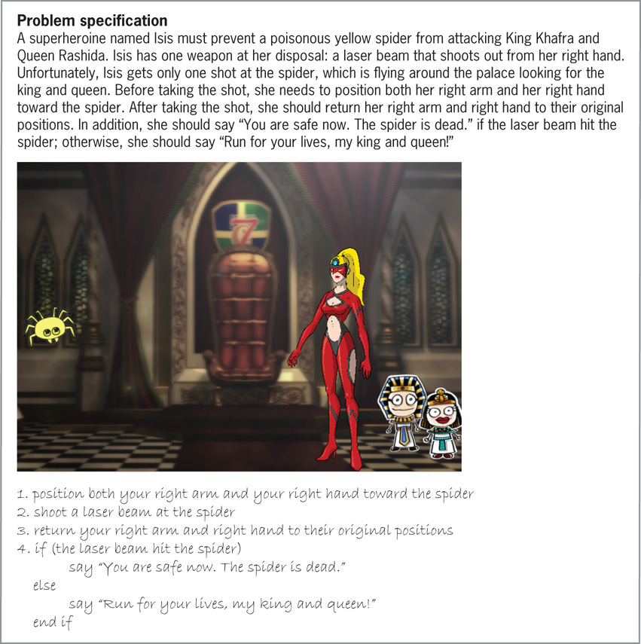
Repeating Program Instructions (cont’d.)
Figure 7-1 A problem that requires the sequence and selection structures

Slide 7
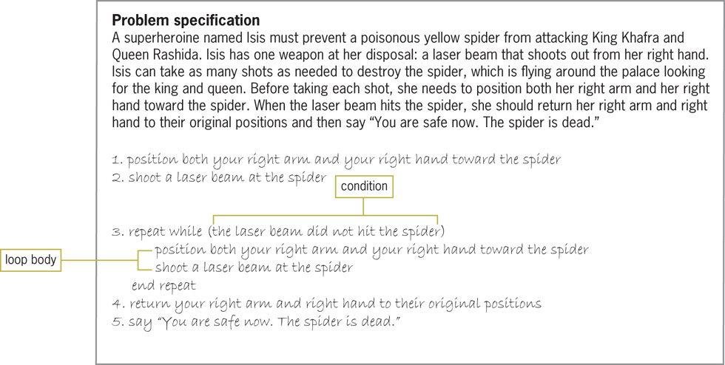
Repeating Program Instructions (cont’d.)
Figure 7-2 A problem that requires the sequence and repetition structures

Slide 8
Using a Pretest Loop to Solve a Real-World Problem
Most loops have a condition and a loop body
Some loops require the user to enter a special sentinel value to end the loop
Sentinel values should be easily distinguishable from the valid data recognized by the program
When a loop’s condition evaluates to true, the instructions in the loop body are processed
Otherwise, the instructions are skipped and processing continues with the first instruction after the loop

Slide 9
Using a Pretest Loop to Solve a Real-World Problem (cont.)
After each processing of the loop body (iteration), the loop’s condition is reevaluated to determine if the instructions should be processed again
A priming read is an instruction that appears before a loop and is used to set up the loop with an initial value entered by the user
An update read is an instruction that appears within a loop that allows the user to enter a new value at each iteration of the loop

Slide 10
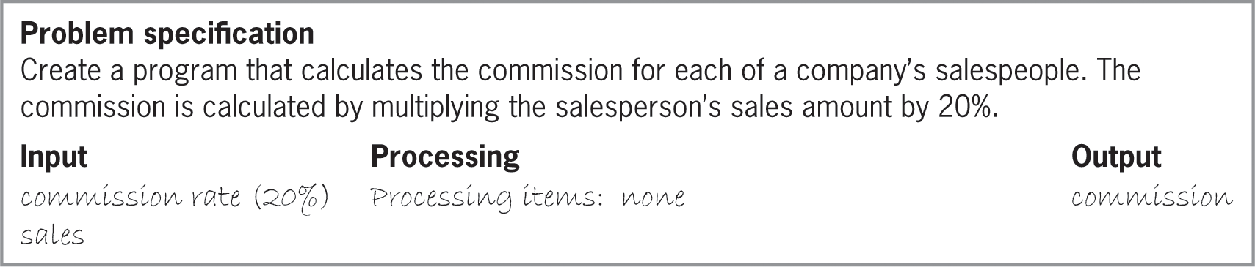
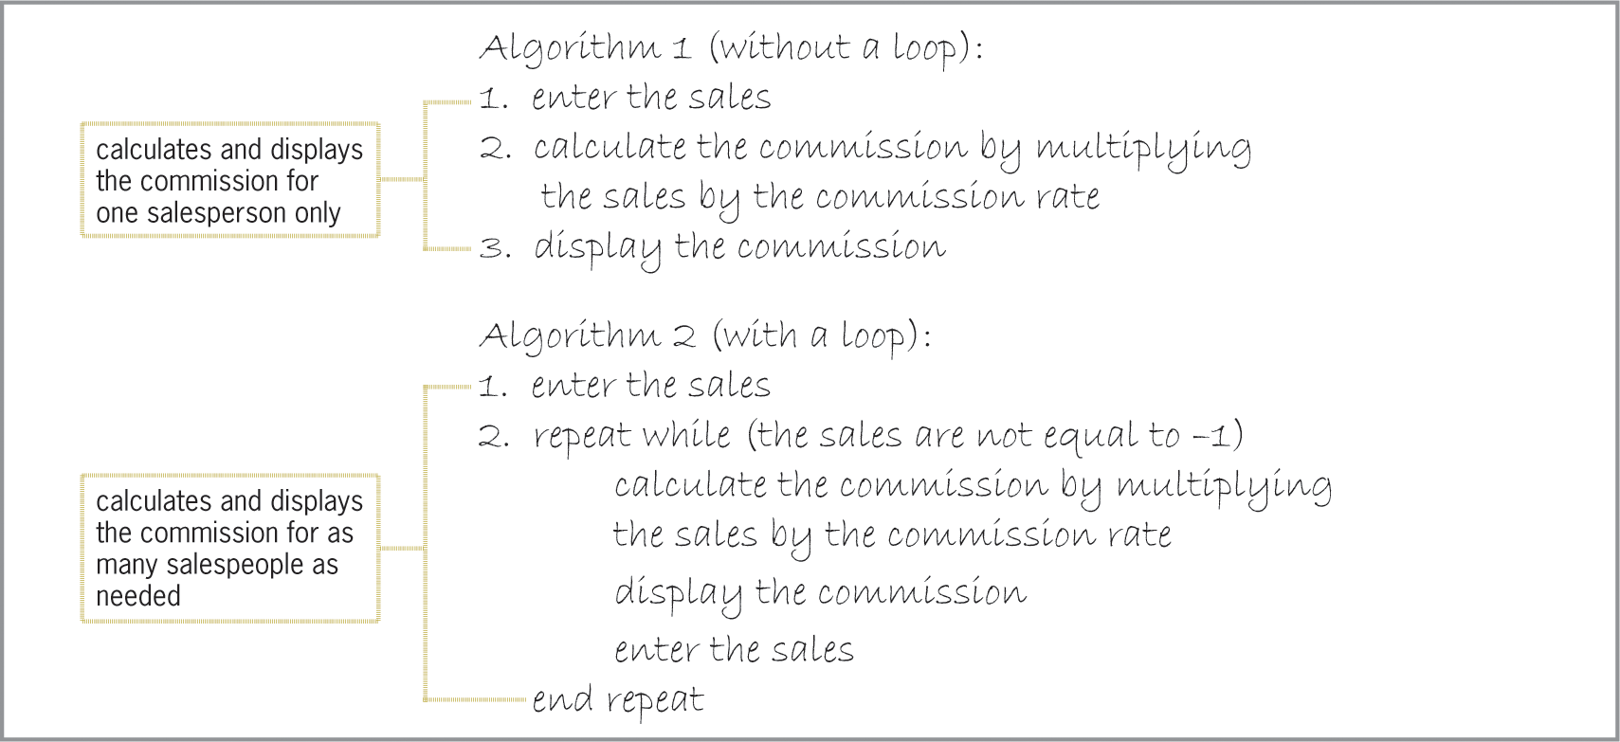
Using a Pretest Loop to Solve a Real-World Problem (cont’d.)
Figure 7-3 Problem specification and IPO chart for the commission program

Slide 11
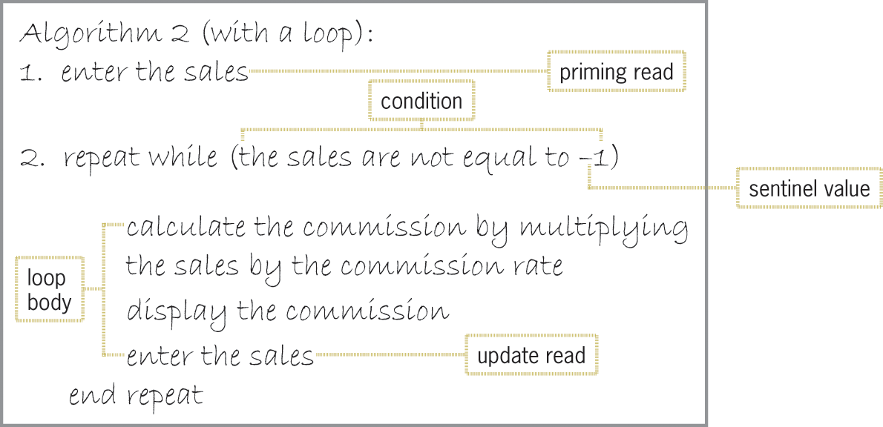
Using a Pretest Loop to Solve a Real-World Problem (cont’d.)
Figure 7-4 Components of Algorithm 2 from Figure 7-3

Slide 12
Flowcharting a Pretest Loop
The diamond symbol in a flowchart is the decision symbol – represents repetition structures
A diamond representing a repetition structure contains a Boolean condition
The condition determines whether the instructions in the loop are processed
A diamond representing a repetition structure has one flowline leading into it and two leading out

Slide 13
Flowcharting a Pretest Loop (cont’d.)
The flowlines leading out are marked “T” (true) and “F” (false)
The “T” line points to the loop body
The “F” line points to the instructions to be processed if the loop’s condition evaluates to false
The flowline entering the diamond and symbols and flowlines of the true path form a circle, or loop
This distinguishes a repetition structure from a selection structure in a flowchart

Slide 14
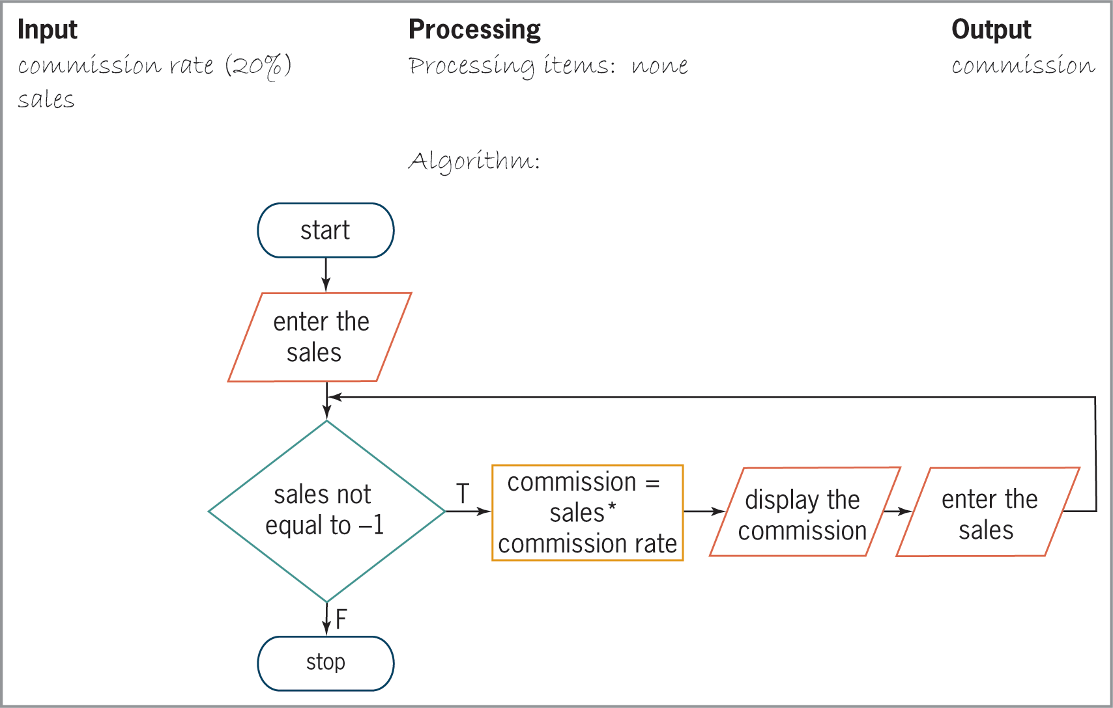
Flowcharting a Pretest Loop (cont’d.)
Figure 7-5 Flowchart for algorithm shown in Figure 7-4

Slide 15

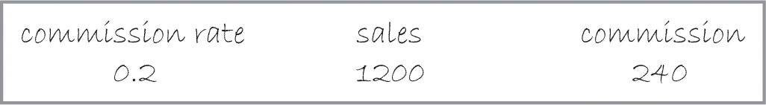
Flowcharting a Pretest Loop (cont’d.)
Figure 7-6 First sales entry recorded in the desk-check table
Figure 7-7 First salesperson’s entry in the desk-check table

Slide 16
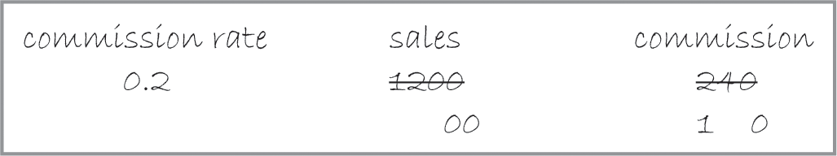
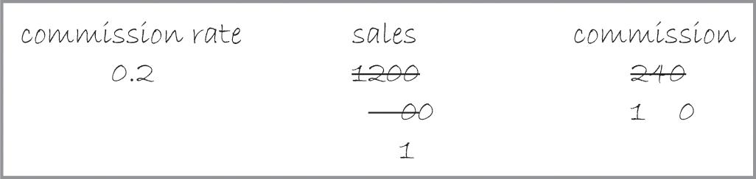
Flowcharting a Pretest Loop (cont’d.)
Figure 7-8 Second salesperson’s entry in the desk-check table
Figure 7-9 Completed desk-check table

Slide 17
The while Statement
You can use the while statement to code a pretest loop in C++
Syntax is:
while (condition)
one statement or a statement block to be processed as long as the condition is true
Must supply looping condition (Boolean expression)
condition can contain constants, variables, functions, arithmetic operators, comparison operators, and logical operators

Slide 18
The while Statement (cont’d.)
Must also provide loop body statements, which are processed repeatedly as long as condition is true
If more than one statement in loop body, must be entered as a statement block (enclosed in braces)
Can include braces even if there is only one statement in the statement block
Good programming practice to include a comment, such as //end while, to mark the end of the while statement

Slide 19
The while Statement (cont’d.)
A loop whose instructions are processed indefinitely is called an infinite loop or endless loop
You can usually stop a program that has entered an infinite loop by pressing Ctrl+c

Slide 20
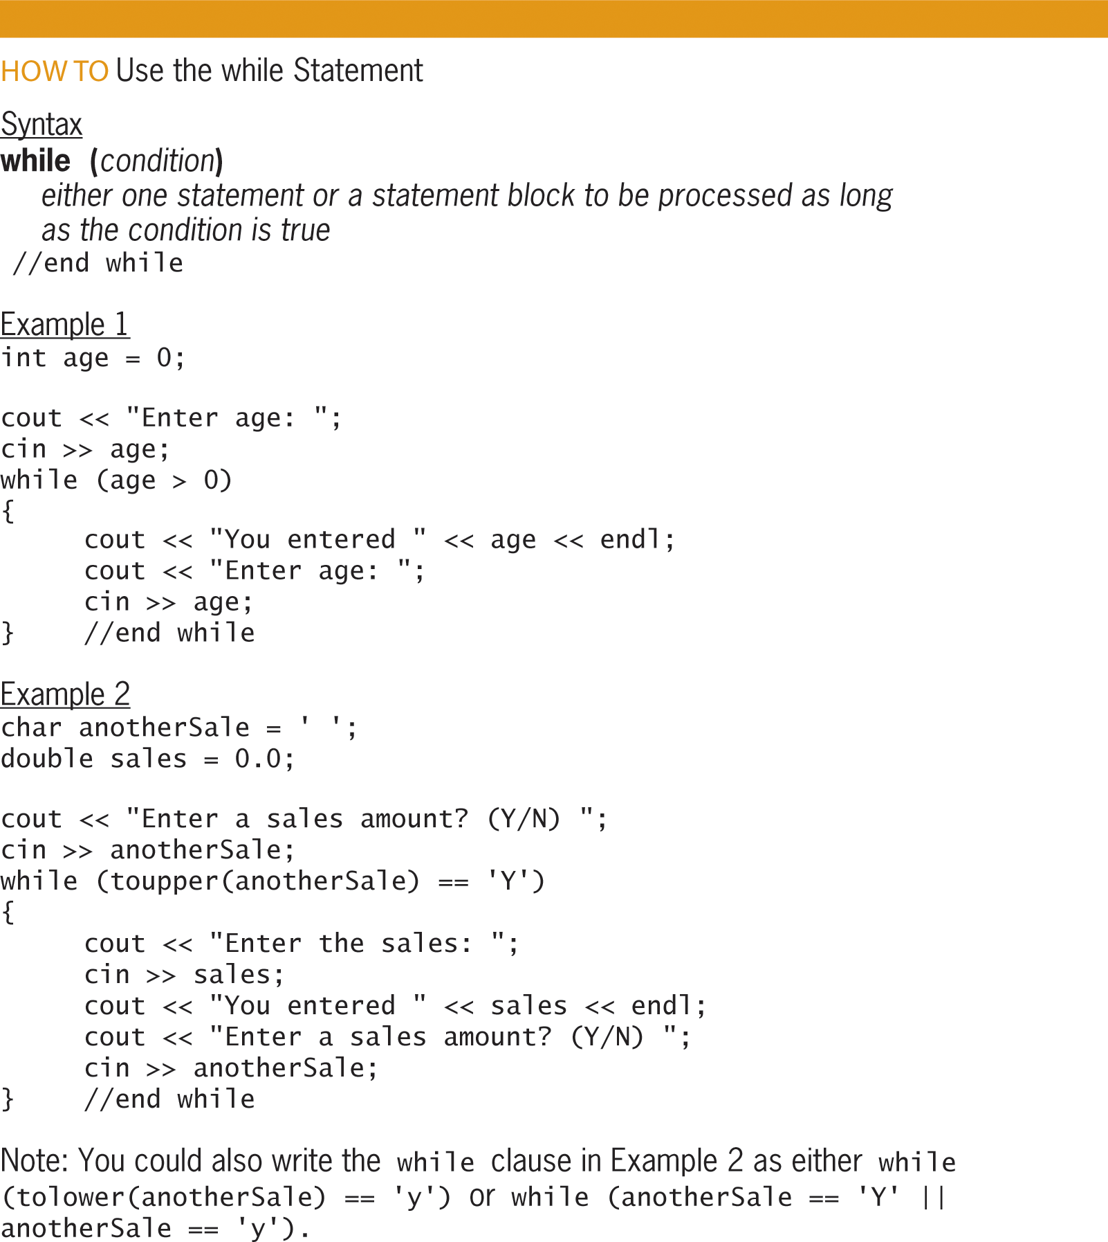
The while Statement (cont’d.)
Figure 7-10 How to use the while statement

Slide 21
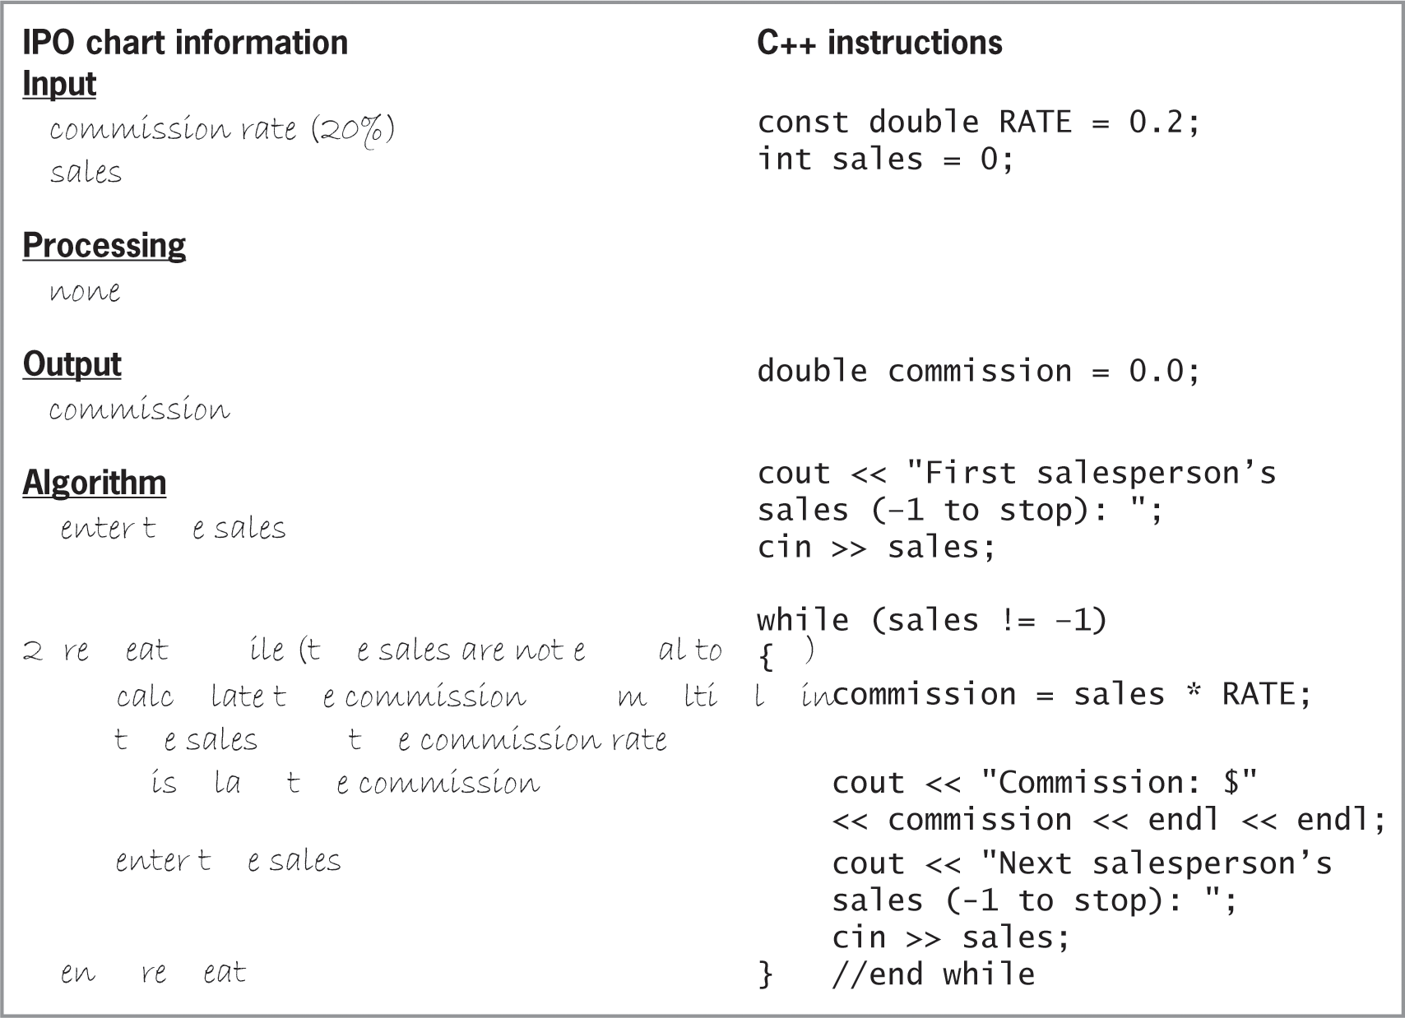
The while Statement (cont’d.)
Figure 7-11 IPO chart information and C++ instructions for the commission program

Slide 22
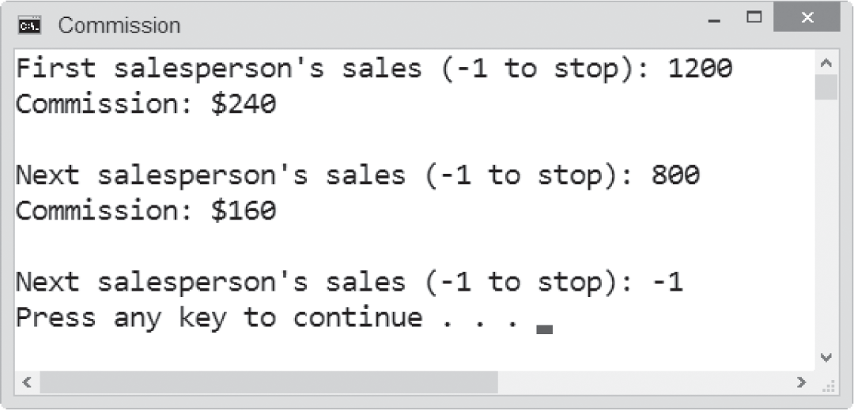
The while Statement (cont’d.)
Figure 7-12 A sample run of the commission program

Slide 23
Using Counters and Accumulators
Some problems require you to calculate a total or average
To do this, you use a counter, accumulator, or both
A counter is a numeric variable used for counting something
An accumulator is a numeric variable used for accumulating (adding together) multiple values
Two tasks are associated with counters and accumulators: initializing and updating

Slide 24
Using Counters and Accumulators (cont’d.)
Initializing means assigning a beginning value to a counter or accumulator (usually 0) – happens once, before the loop is processed
Updating (or incrementing) means adding a number to the value of a counter or accumulator
A counter is updated by a constant value (usually 1)
An accumulator is updated by a value that varies
Update statements are placed in the body of a loop since they must be performed at each iteration

Slide 25
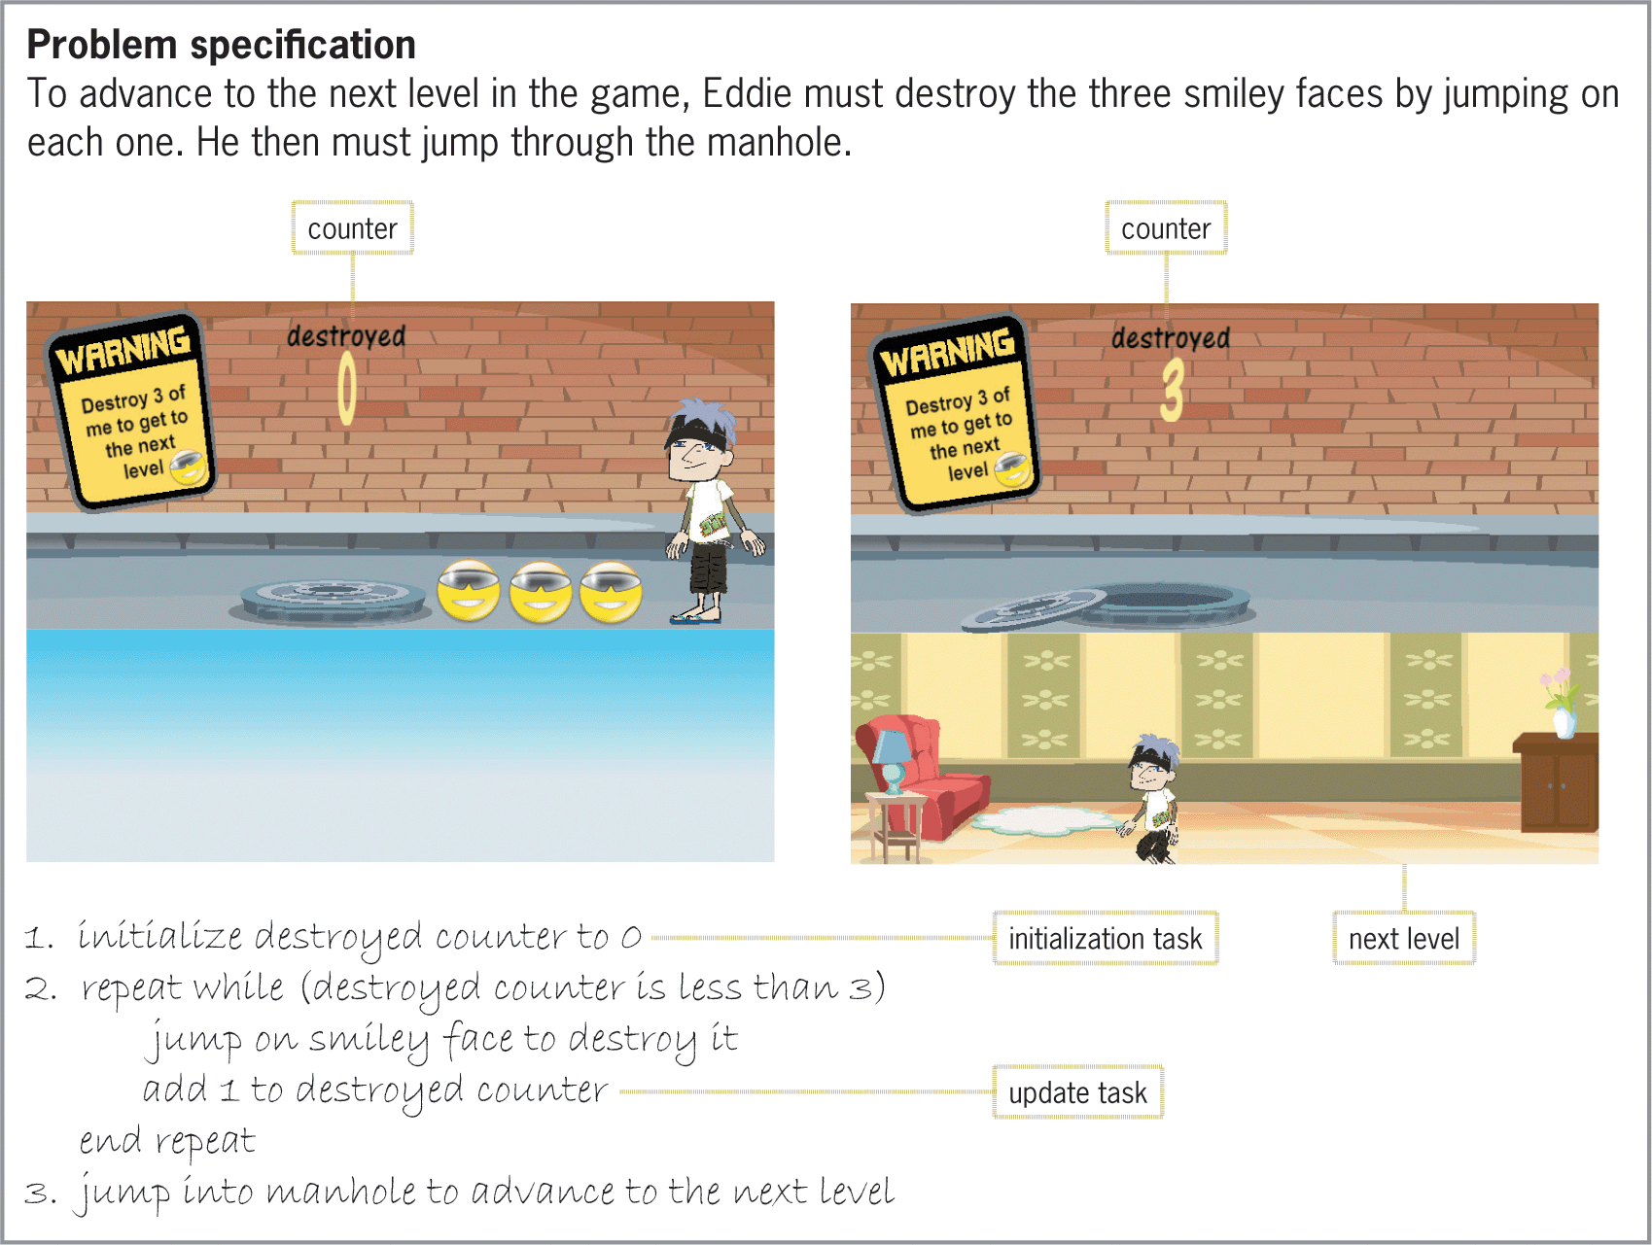
Using Counters and Accumulators (cont’d.)
Figure 7-13 Example of a partial game program that uses a counter

Slide 26
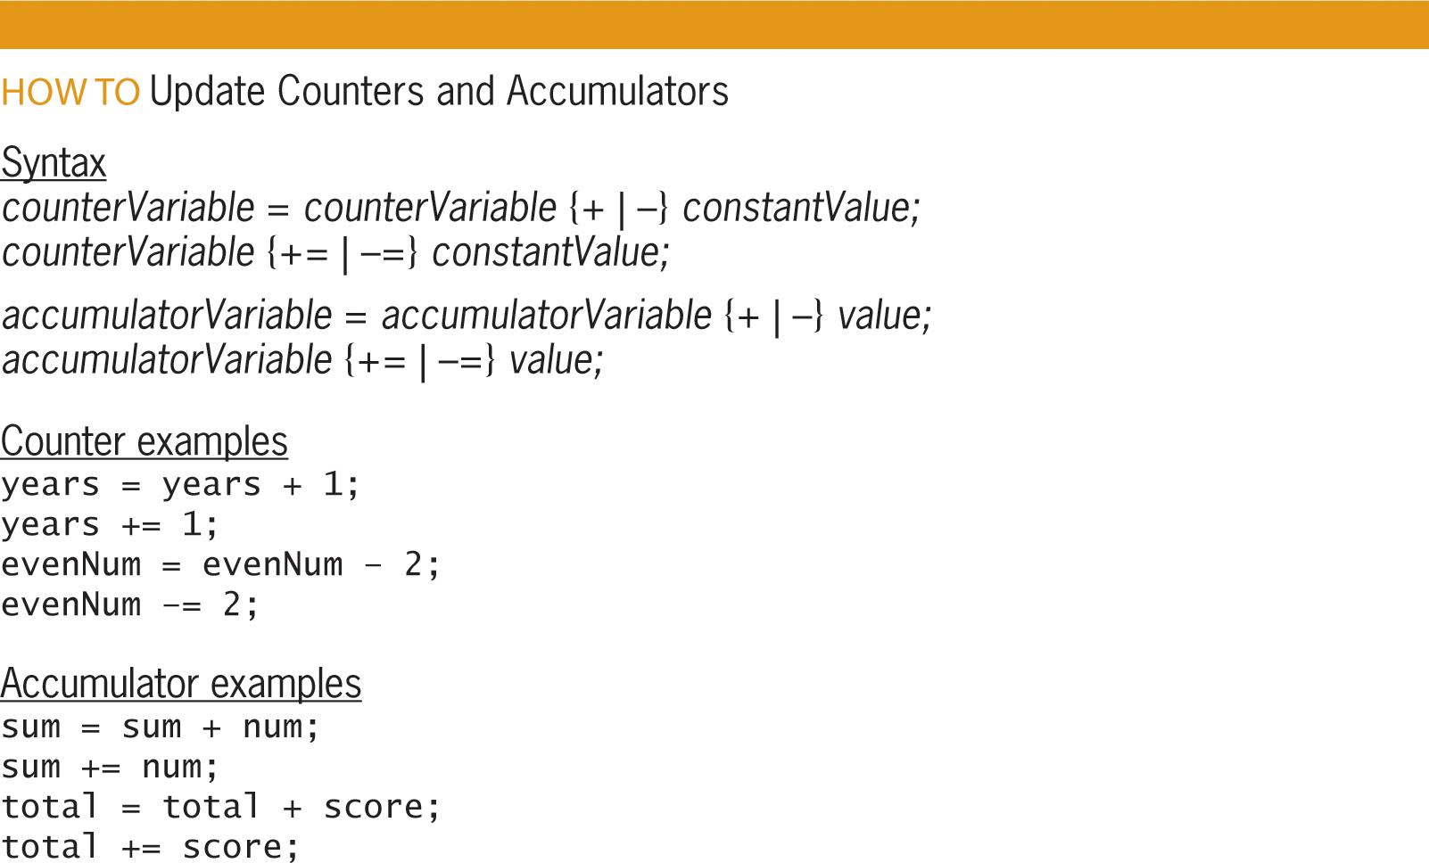
Using Counters and Accumulators (cont’d.)
Figure 7-14 Syntax and examples of update statements for counters and accumulators

Slide 27
The Stock Price Program
Example problem and program solution (following slides)
Program takes in a sequence of stock prices from the keyboard and outputs their average
Uses a counter to keep track of the number of prices entered and an accumulator to keep track of the total
Both are initialized to 0
The loop ends when the user enters a sentinel value (-1)

Slide 28
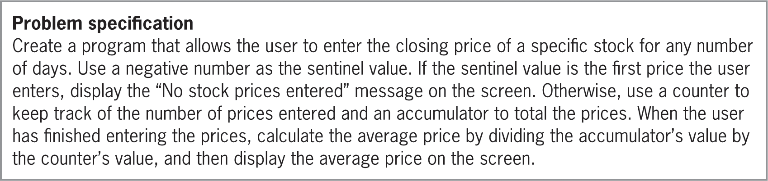
The Stock Price Program (cont’d.)
Figure 7-15 Problem specification for the Sales Express program

Slide 29
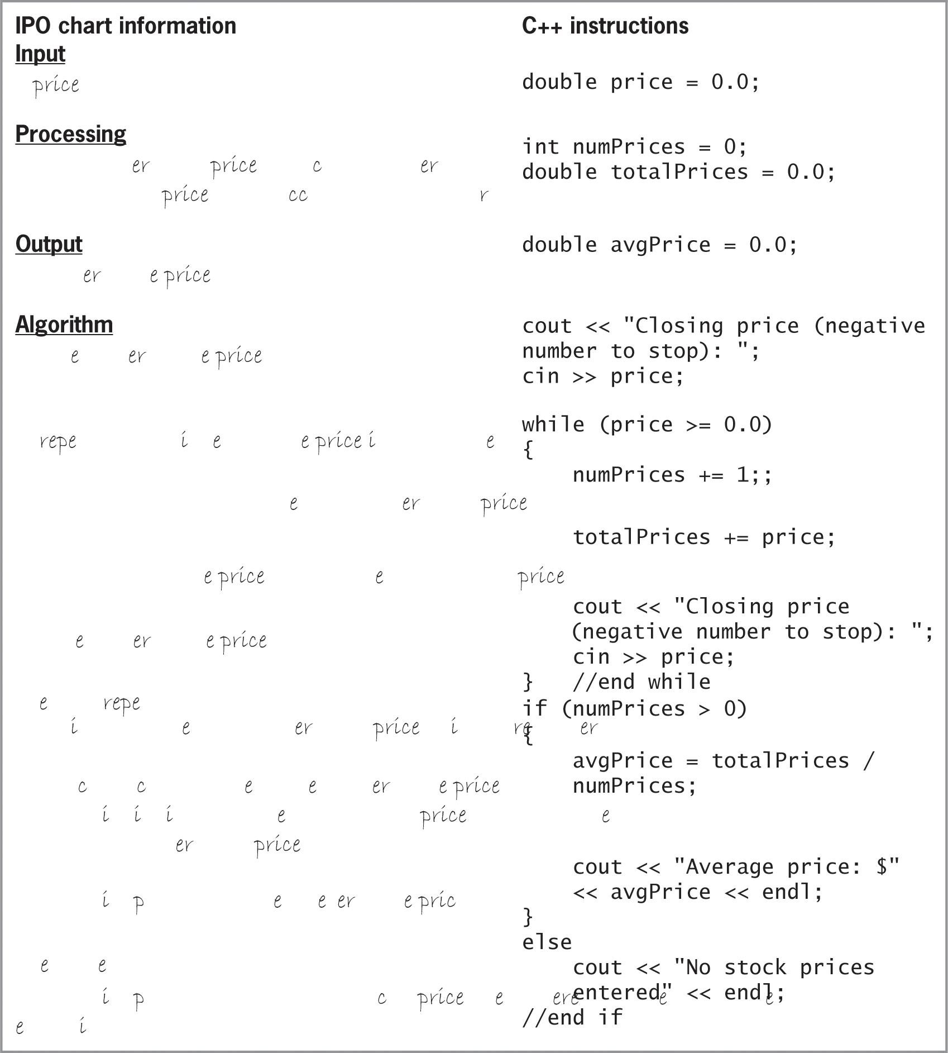
The Stock Price Program (cont’d.)
Figure 7-15 IPO chart information and C++ instructions for the Stock Price program

Slide 30
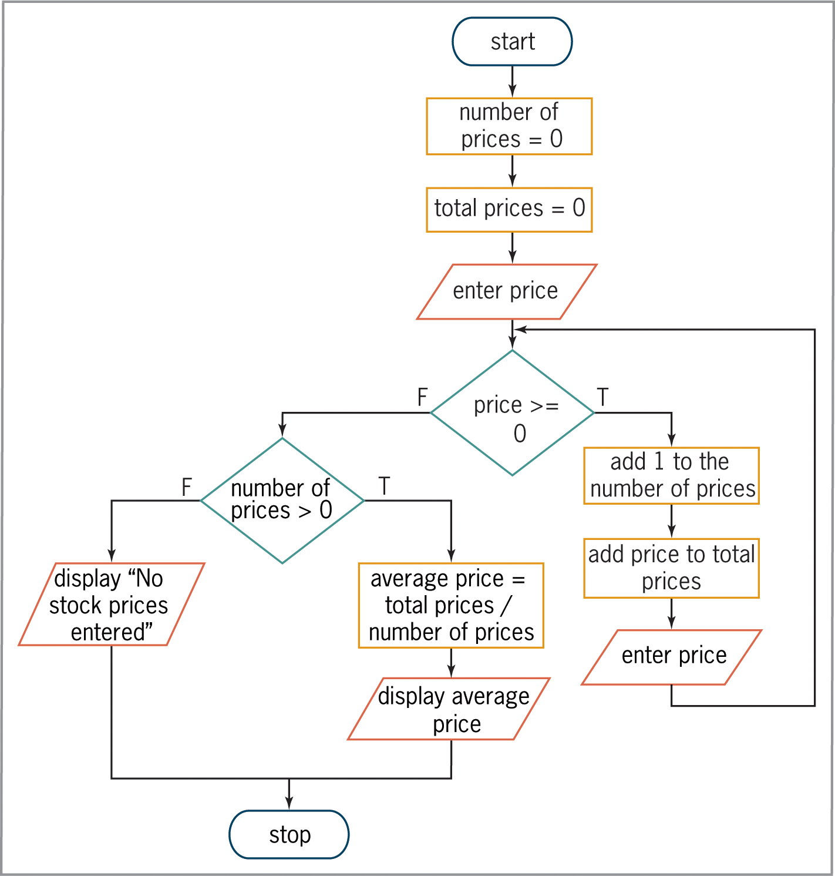
The Stock Price Program (cont’d.)
Figure 7-16 Flowchart for the Stock Price program

Slide 31
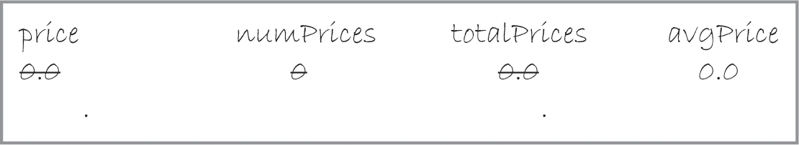
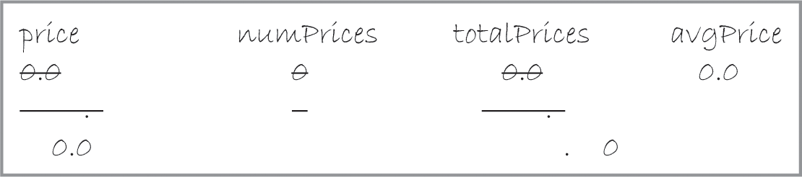
The Stock Price Program (cont’d.)
Figure 7-17 Desk-check table after the first update to the counter and accumulator variables
Figure 7-18 Desk-check table after the second update to the counter and accumulator variables

Slide 32
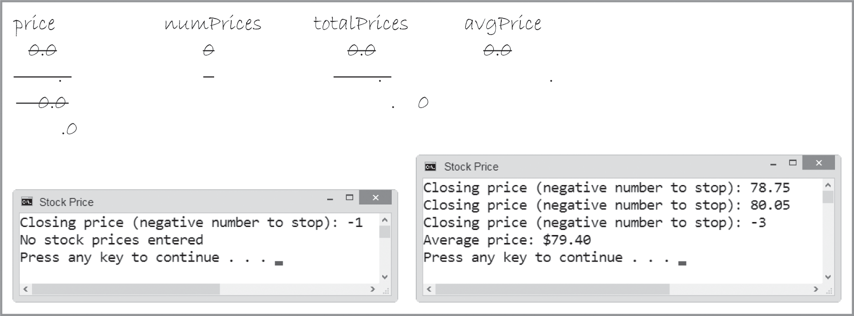
The Stock Price Program (cont’d.)
Figure 7-19 Completed desk-check table and sample runs for the Stock Price program

Slide 33
Counter-Controlled Pretest Loops
Loops can be controlled using a counter rather than a sentinel value
These are called counter-controlled loops
Example problem and program solution (following slides)
Counter-controlled loop is used that totals the quarterly sales from three regions
Loop repeats three times, once for each region, using a counter to keep track

Slide 34
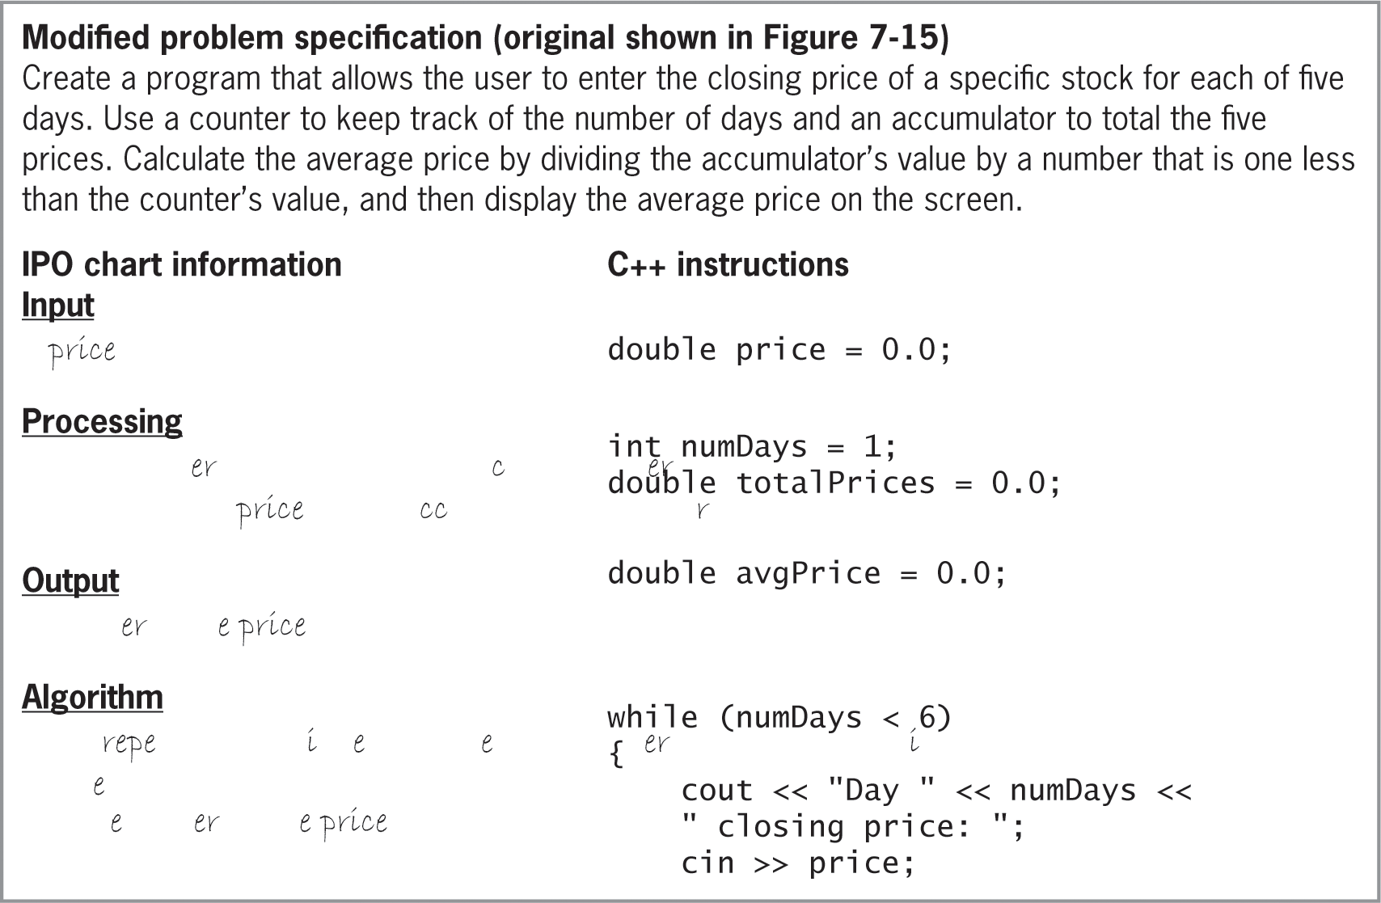
Counter-Controlled Pretest Loops (cont’d.)
Figure 7-20 Problem specification, IPO chart information, and C++ instructions for the modified Stock Price program

Slide 35
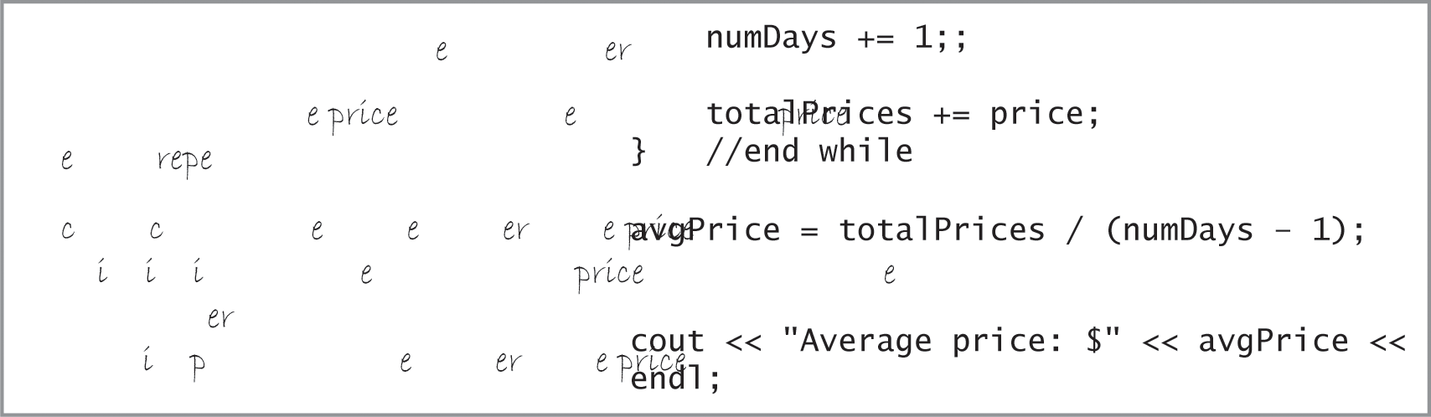
Counter-Controlled Pretest Loops (cont’d.)
Figure 7-20 Problem specification, IPO chart information, and C++ instructions for the modified Stock Price program (cont’d.)

Slide 36
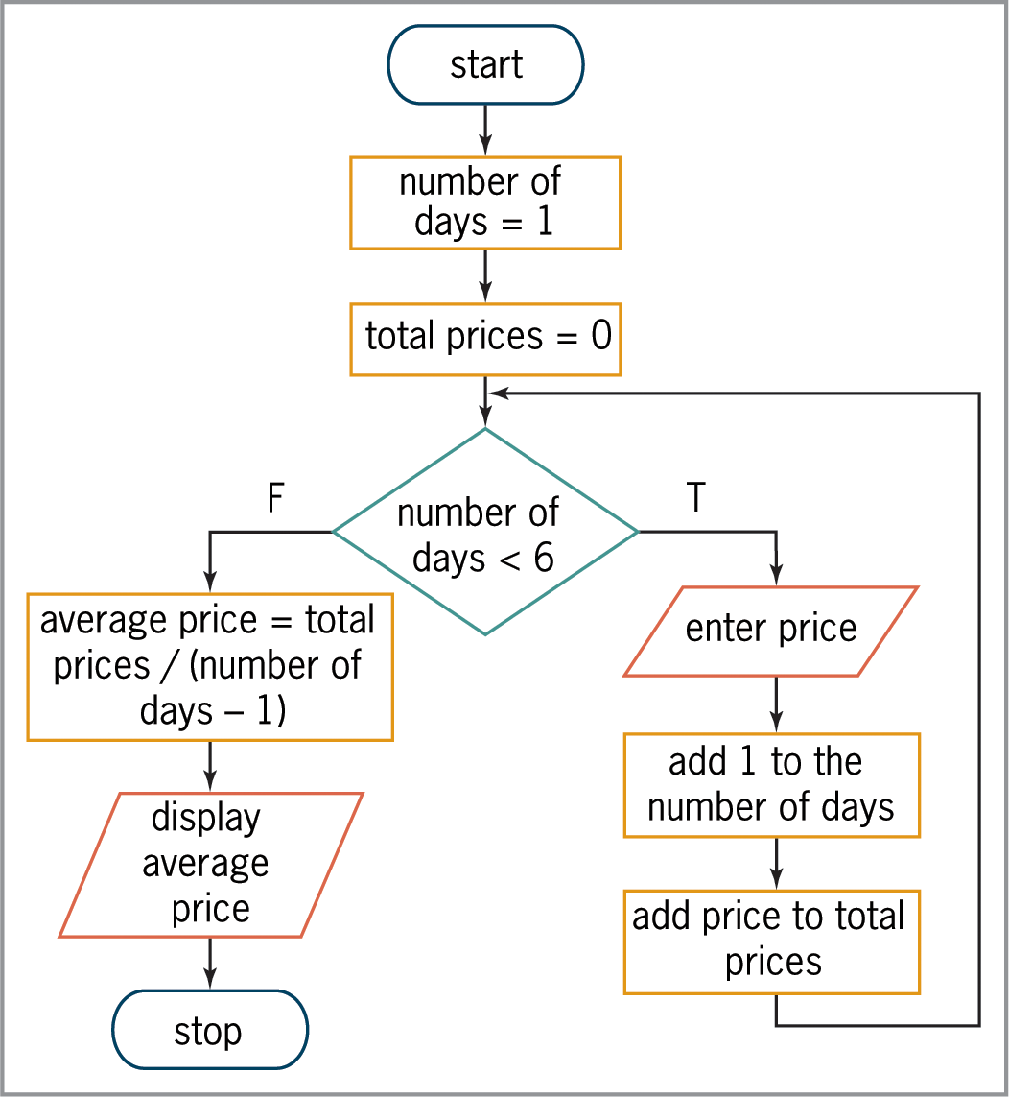
Counter-Controlled Pretest Loops (cont’d.)
Figure 7-21 Flowchart for the modified Stock Price program

Slide 37
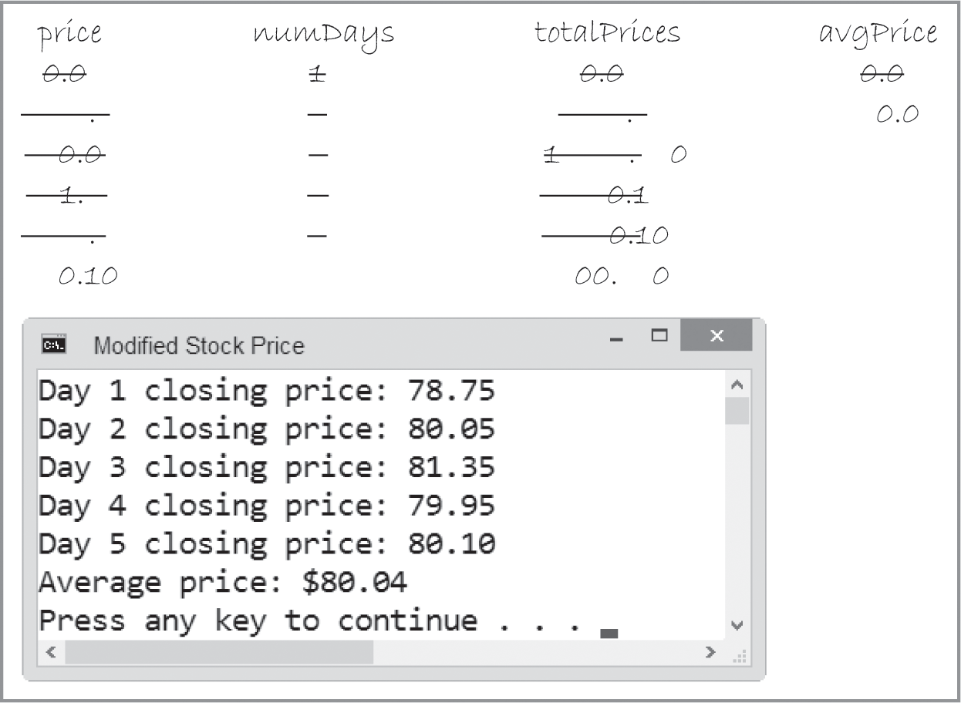
Counter-Controlled Pretest Loops (cont’d.)
Figure 7-22 Completed desk-check table and sample run for the modified Stock Price program

Slide 38
The for Statement
The for statement can also be used to code any pretest loop in C++
Commonly used to code counter-controlled pretest loops (more compact than while in this case)
Syntax:
for ([initialization]; condition; [update])
one statement or a statement block to be
processed as long as condition is true
initialization and update arguments are optional

Slide 39
The for Statement (cont’d.)
initialization argument usually creates and initializes a counter variable
Counter variable is local to for statement (can only be used inside the loop)
condition argument specifies condition that must be true for the loop body to be processed
condition must be a Boolean expression
May contain variables, constants, functions, arithmetic operators, comparison operators, and logical operators

Slide 40
The for Statement (cont’d.)
Loop ends when condition evaluates to false
update argument usually contains an expression that updates the counter variable
Loop body follows the for clause
Must be placed in braces if it contains more than one statement
Braces can be used even if the loop body contains only one statement
Good programming practice to place a comment, such as //end for, to mark the end of a for loop

Slide 41
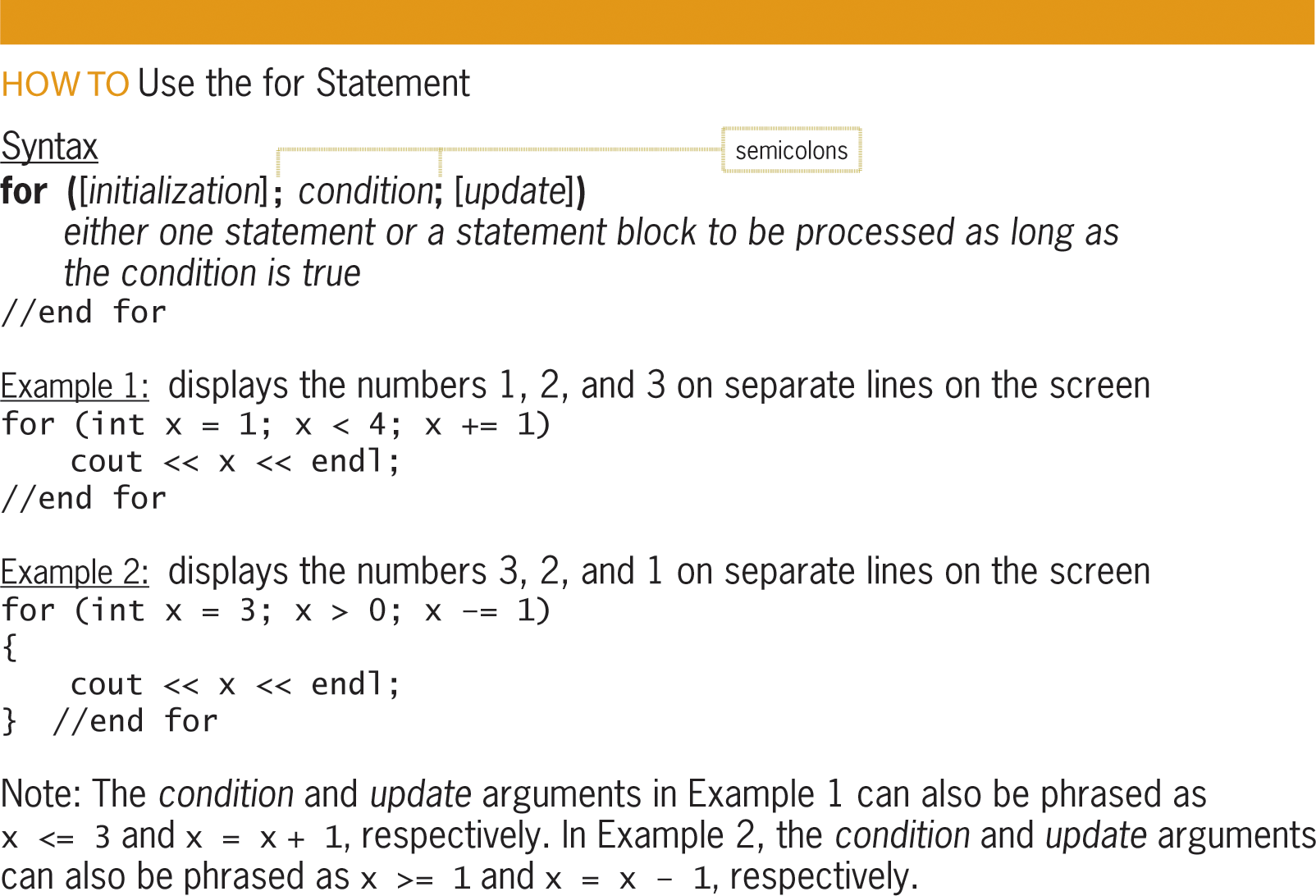
The for Statement (cont’d.)
Figure 7-23 How to use the for statement

Slide 42
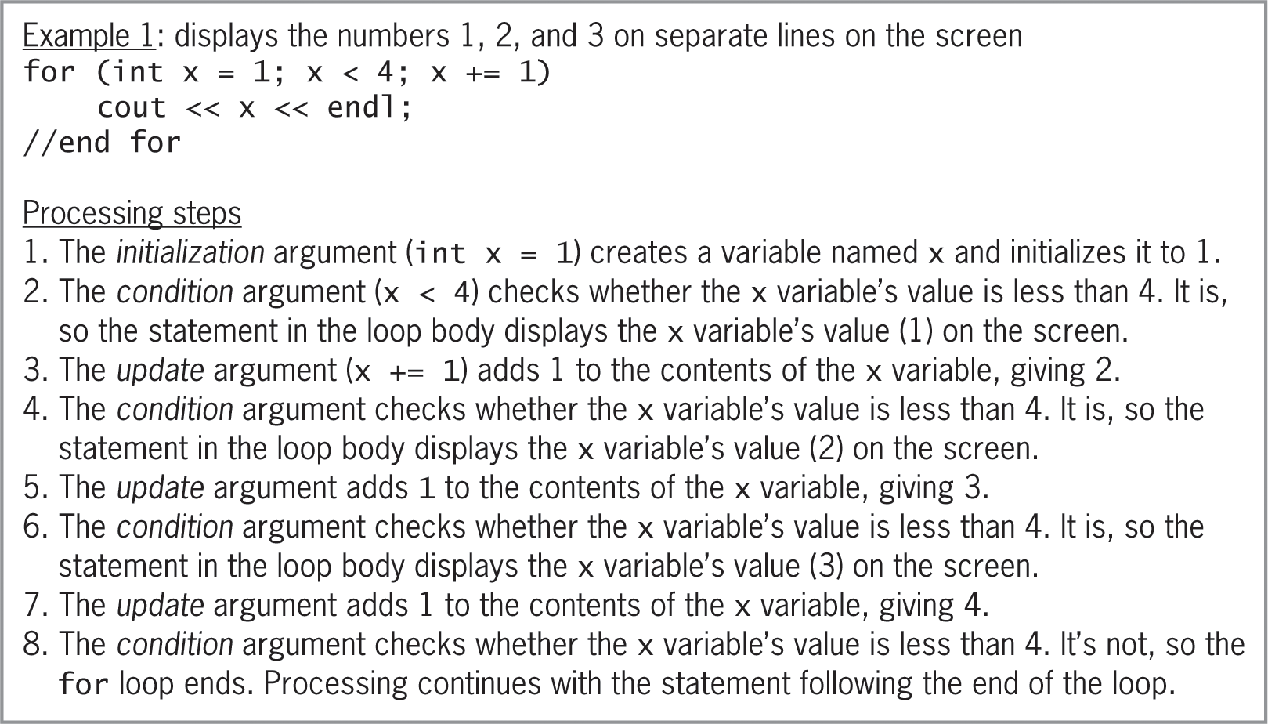
The for Statement (cont’d.)
Figure 7-24 Processing steps for Example 1’s code

Slide 43
The Total Payroll Program
Extended example of a problem and program solution (following slides)
Program totals up the payroll from three stores using a for loop

Slide 44
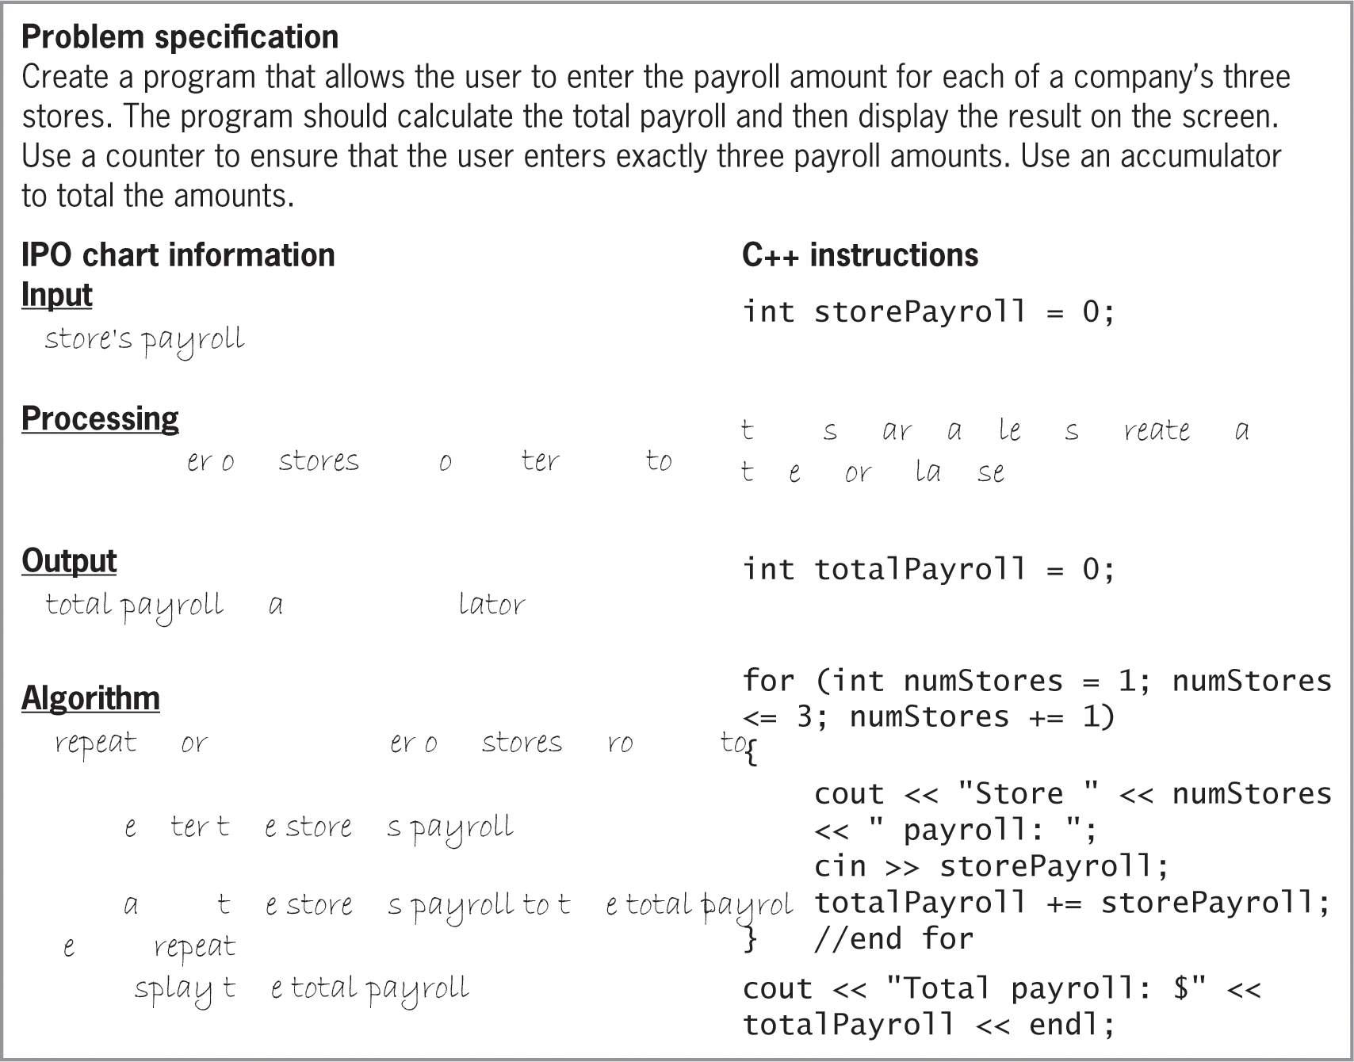
The Total Payroll Program (cont’d.)
Figure 7-25 Program specification, IPO chart information, and C++
instructions for the Total Payroll program

Slide 45

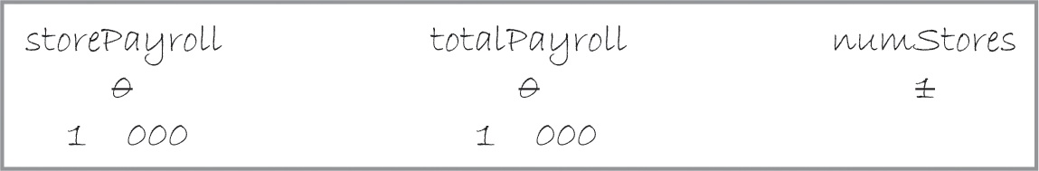
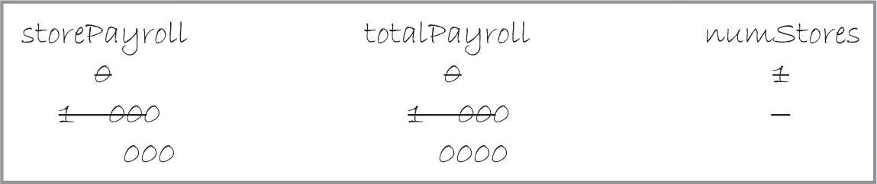
The Total Payroll Program (cont’d.)
Figure 7-26 Results of processing the declaration statements and initialization argument
Figure 7-27 Desk-check table after update argument is processed first time
Figure 7-28 Desk-check table after update argument is processed second time

Slide 46
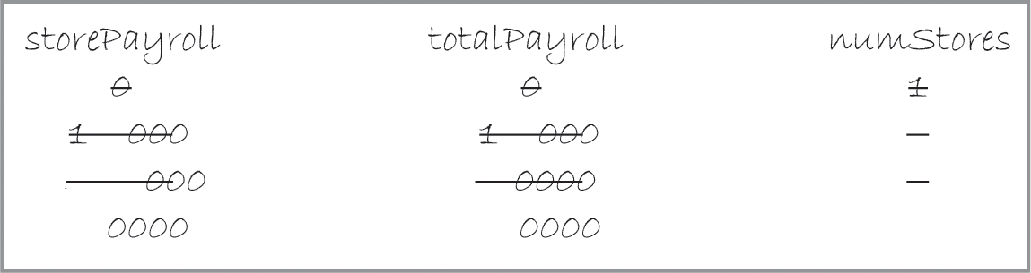
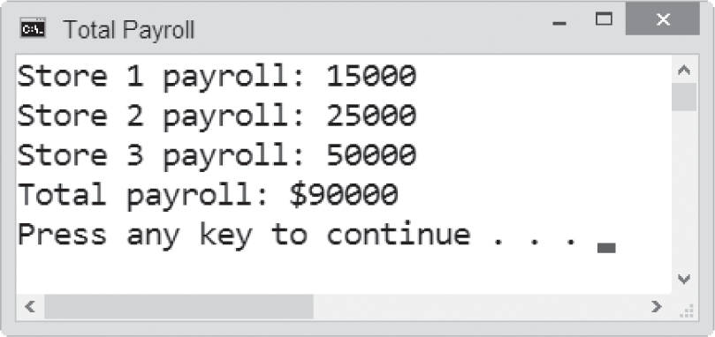
The Total Payroll Program (cont’d.)
Figure 7-29 Desk-check table after update argument is processed third time
Figure 7-30 Sample run of the Total Payroll program

Slide 47
The Tip Program
Extended example of a problem and program solution (following slides)
Calculates the ti for a given sales amount using three different rates
A for loop keeps track of each of the three rates

Slide 48
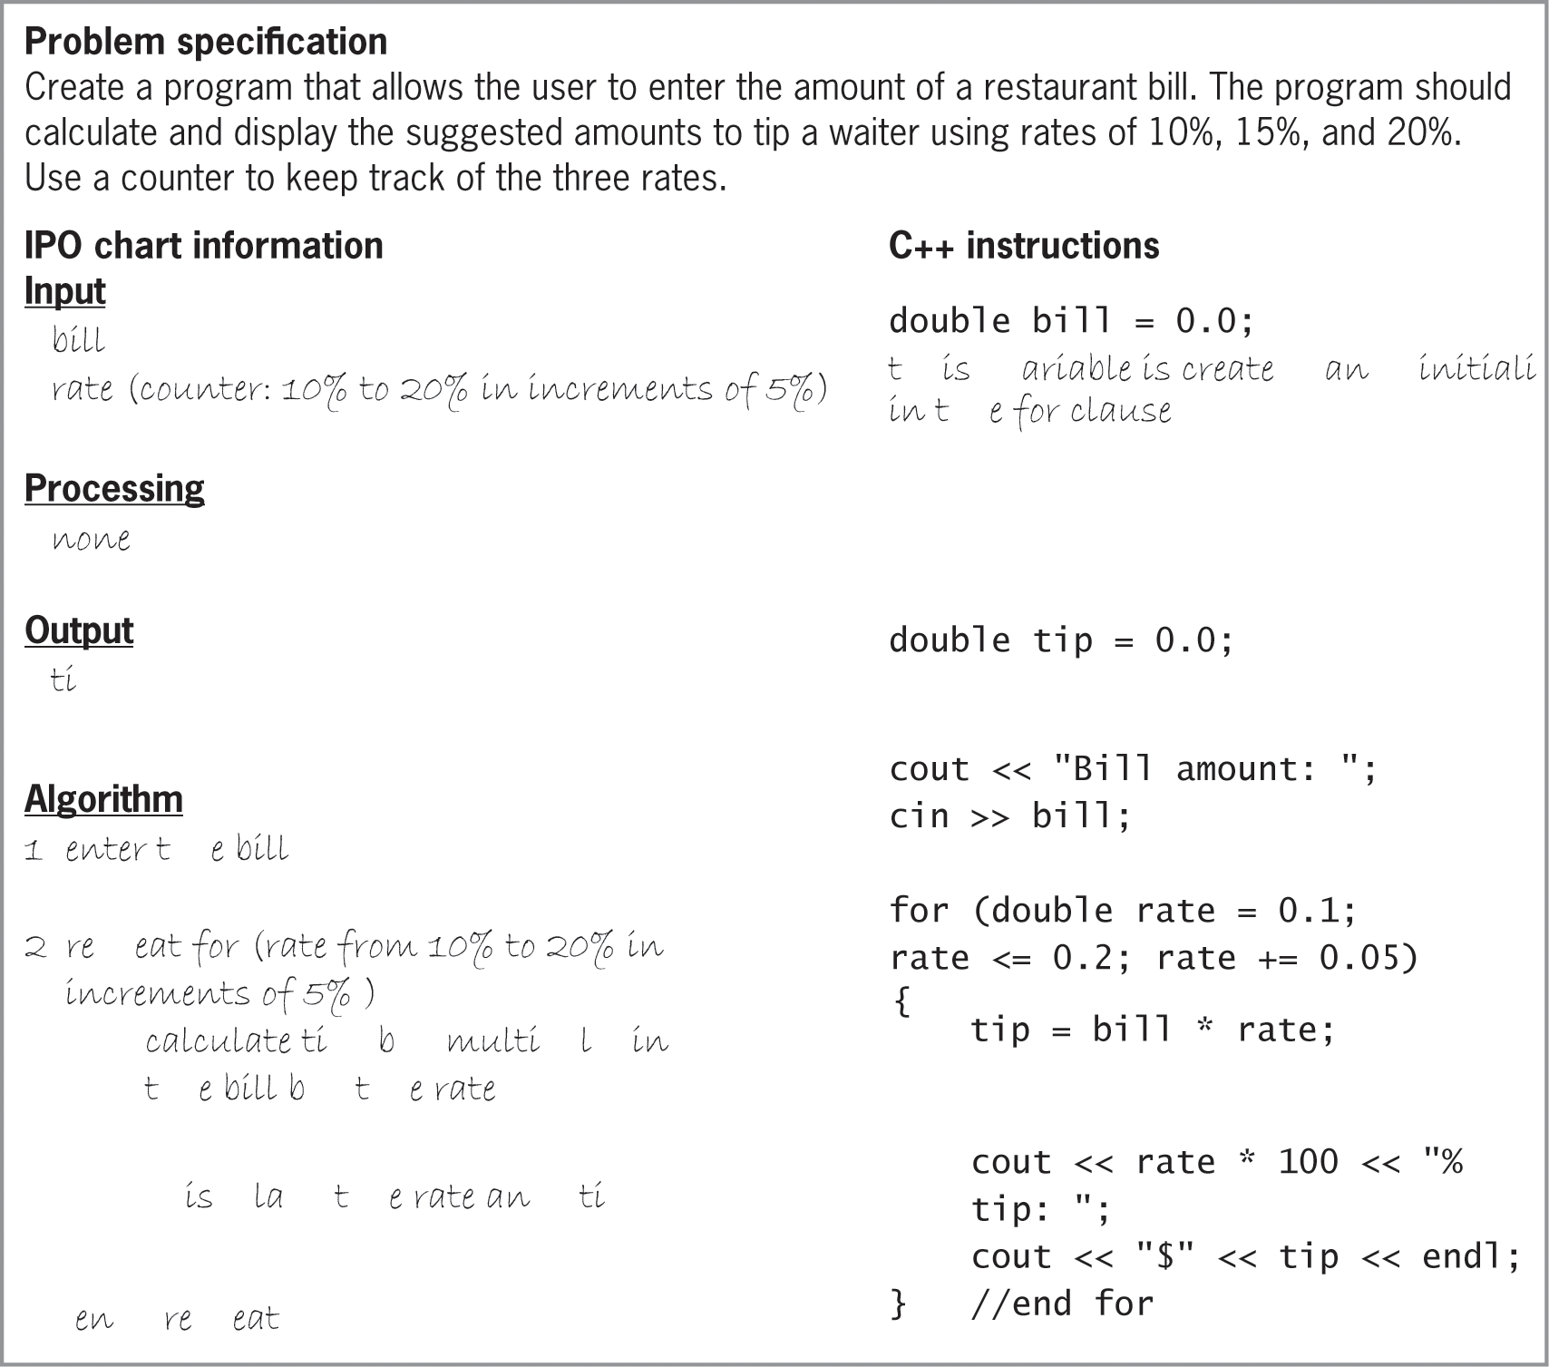
The Tip Program (cont’d.)
Figure 7-31 Problem specification, IPO chart information, and C++
instructions for the Tip program

Slide 49
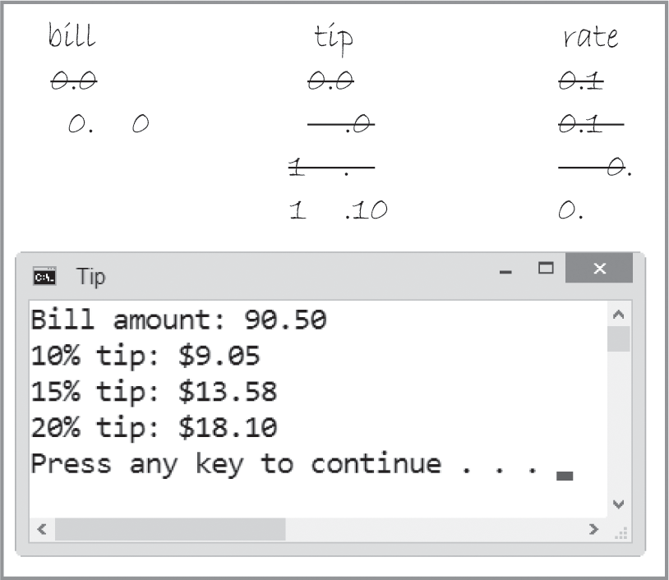
The Tip Program (cont’d.)
Figure 7-32 Desk-check table and sample run of the Tip program

Slide 50
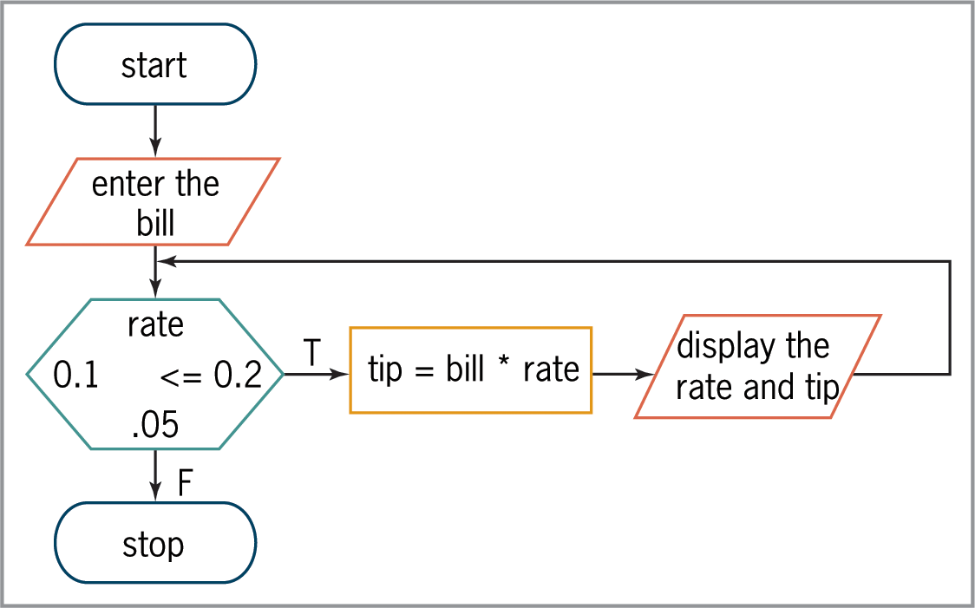
The Tip Program (cont’d.)
Figure 7-33 Tip program’s algorithm shown in flowchart form

Slide 51
Another Version of the Commission Program
Alternative version of the Commission program (following slides)
Uses a for loop instead of a while loop

Slide 52
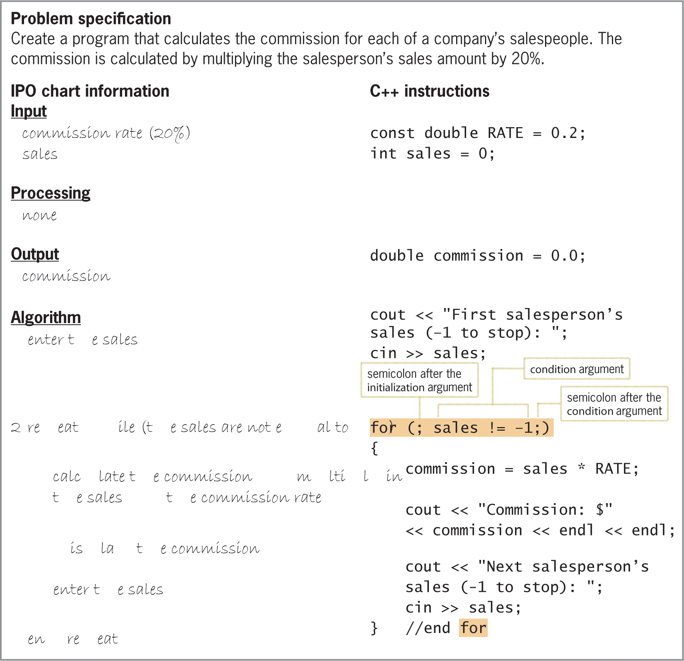
Another Version of the Commission Program (cont’d.)
Figure 7-34 IPO chart information and modified C++ instructions for the Commission program

Slide 53
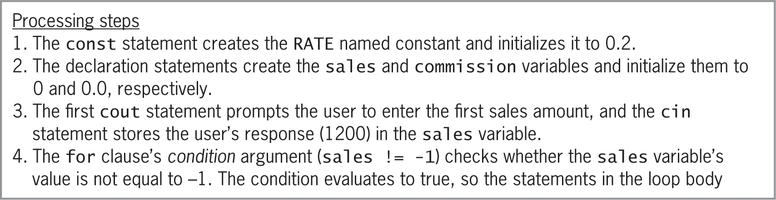
Another Version of the Commission Program (cont’d.)
Figure 7-35 Processing steps and sample run for the Commission program shown in Figure 7-34

Slide 54
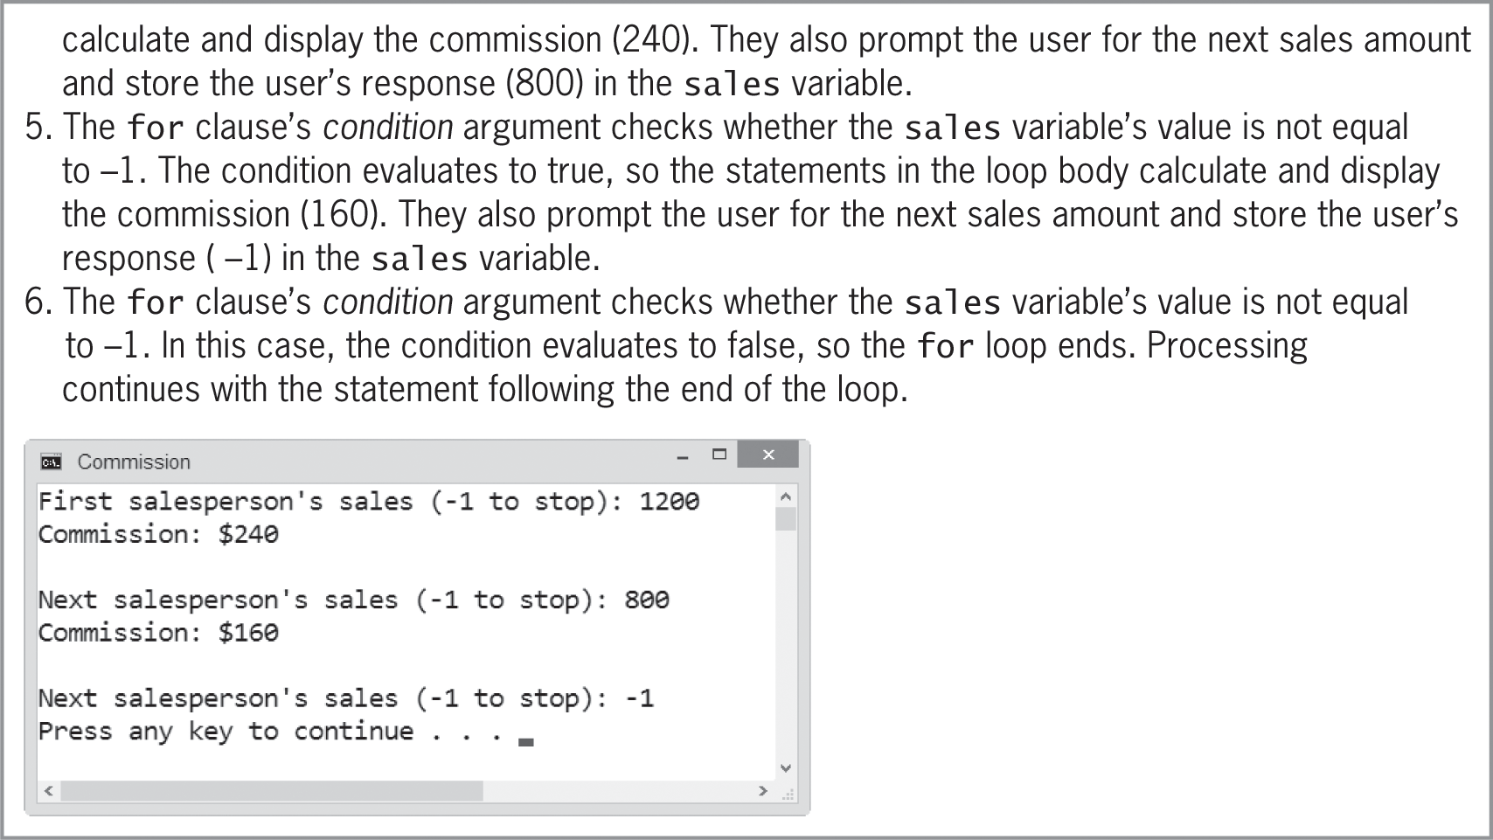
Another Version of the Commission Program (cont’d.)
Figure 7-35 Processing steps and sample run for the Commission program shown in Figure 7-34 (cont’d.)

Slide 55
The Even Integers Program
Program to calculate and display the sum of three integers entered by the user (following slides)
Shows incorrect solution via a for loop
Shows eventual correct solution via while loop

Slide 56
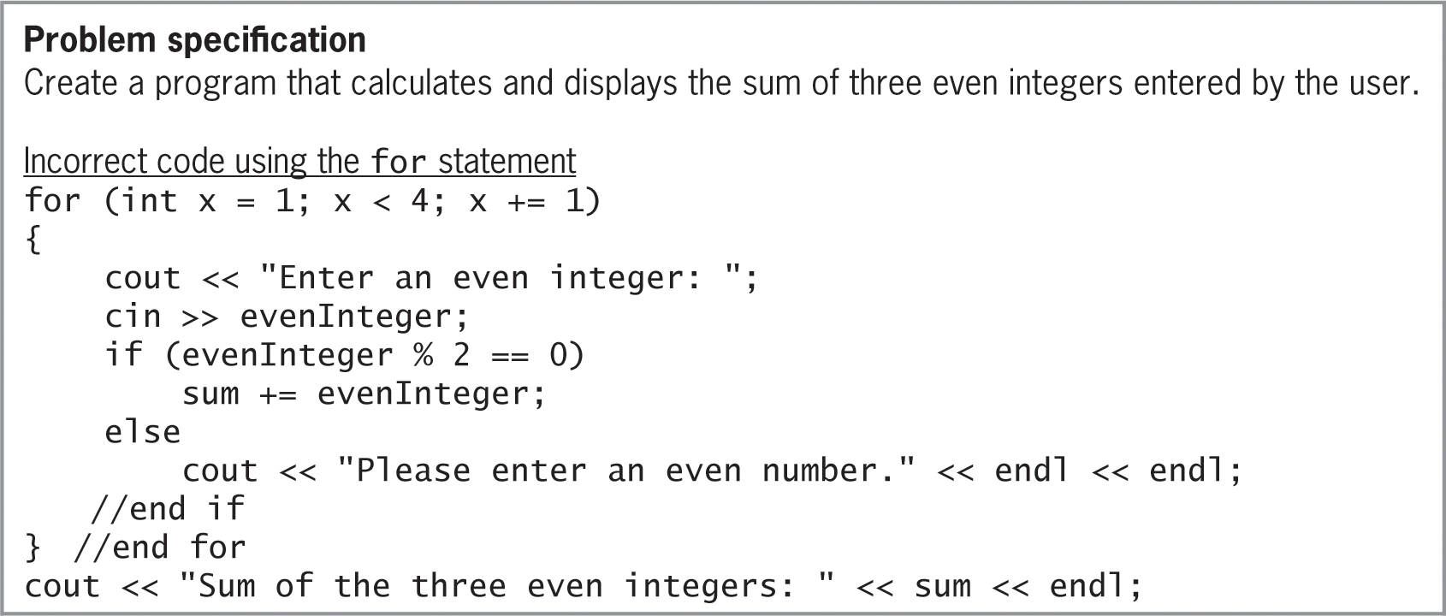
The Even Integers Program (cont’d.)
Figure 7-36 Problem specification and code of the incorrect Even Integers Program

Slide 57
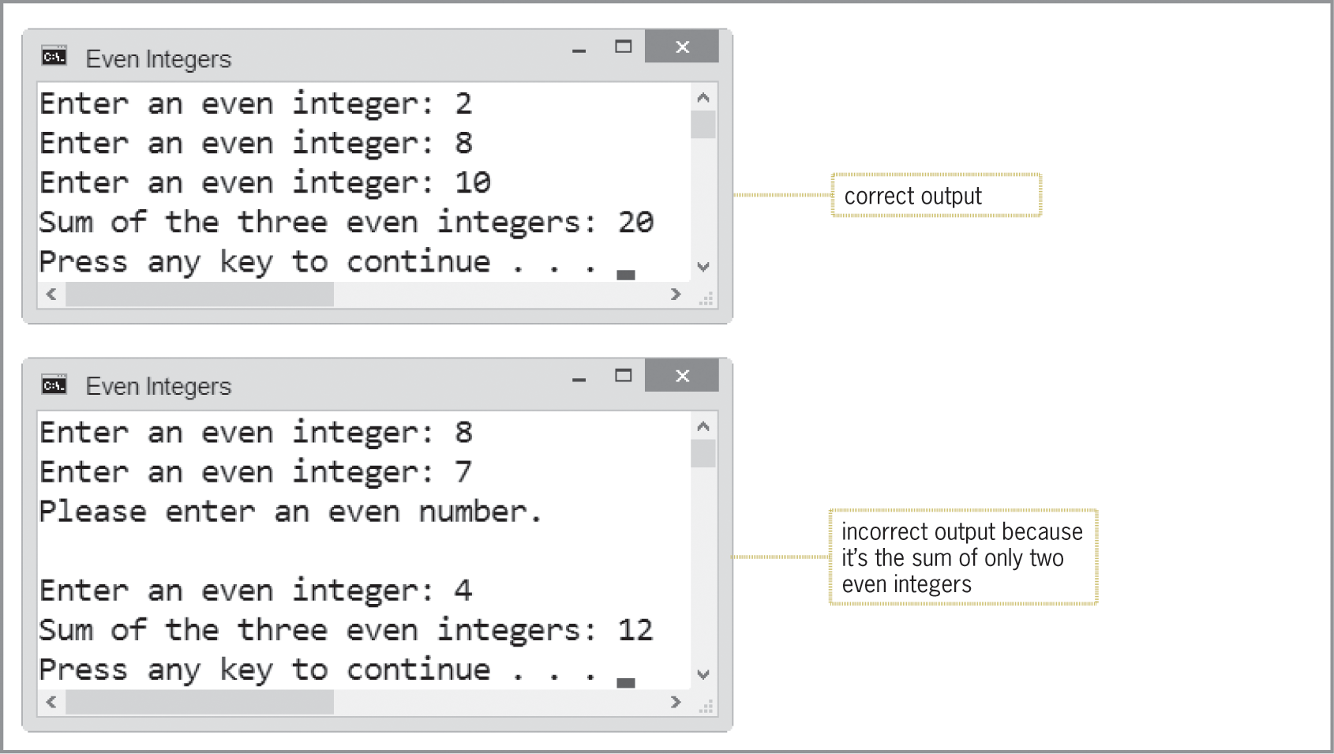
The Even Integers Program (cont’d.)
Figure 7-36 Sample runs of the incorrect Even Integers Program

Slide 58
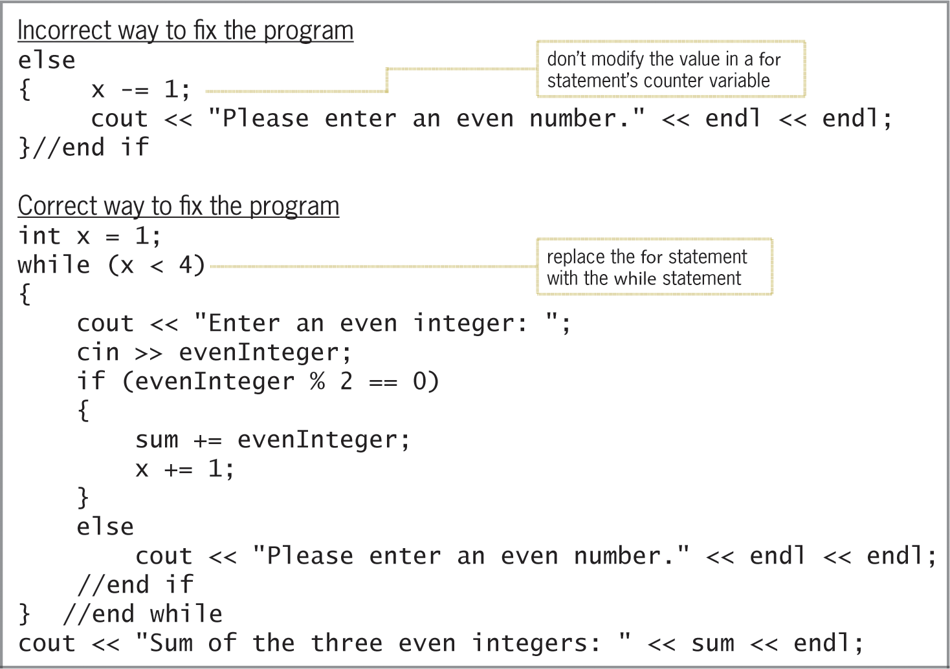
The Even Integers Program (cont’d.)
Figure 7-37 Incorrect and correct ways to fix the Even Integers Program

Slide 59
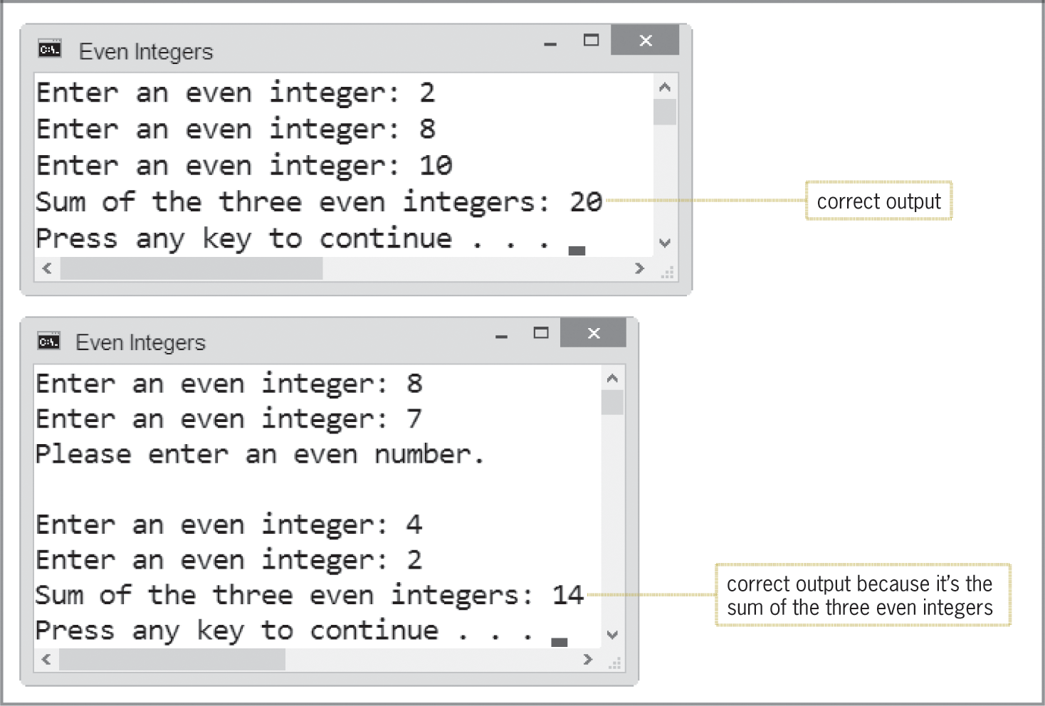
The Even Integers Program (cont’d.)
Figure 7-37 Sample runs of the correct solution to the Even Integers Program

Slide 60
Summary
Use the repetition structure (or loop) to repeatedly process one or more instructions
Loop repeats as long as looping condition is true (or until loop exit condition has been met)
A repetition structure can be pretest or posttest
In a pretest loop, the loop condition is evaluated before instructions in loop body are processed
In a posttest loop, the evaluation occurs after instructions in loop body are processed

Slide 61
Summary (cont’d.)
Condition appears at the beginning of a pretest loop – must be a Boolean expression
If condition evaluates to true, the instructions in the loop body are processed; otherwise, the loop body instructions are skipped
Some loops require the user to enter a special sentinel value to end the loop
Sentinel values should be easily distinguishable from valid data recognized by the program
Other loops are terminated by using a counter

Slide 62
Summary (cont’d.)
Input instruction that appears above a pretest loop’s condition is the priming read
Sets up the loop by getting first value from user
Input instruction that appears within the loop is the update read
Gets the remaining values (if any) from user
In most flowcharts, diamond (decision symbol) is used to represent a repetition structure’s condition

Slide 63
Summary (cont’d.)
Counters and accumulators are used in repetition structures to calculate totals and averages
All counters and accumulators must be initialized and updated
Counters are updated by a constant value
Accumulators are updated by a variable amount
You can use either the while statement or the for statement to code a pretest loop in C++

Slide 64
Lab 7-1: Stop and Analyze
Study the program in Figure 7-38 on page 229 and answer the questions
The program calculates the average number of text messages sent each day for 7 days

Slide 65
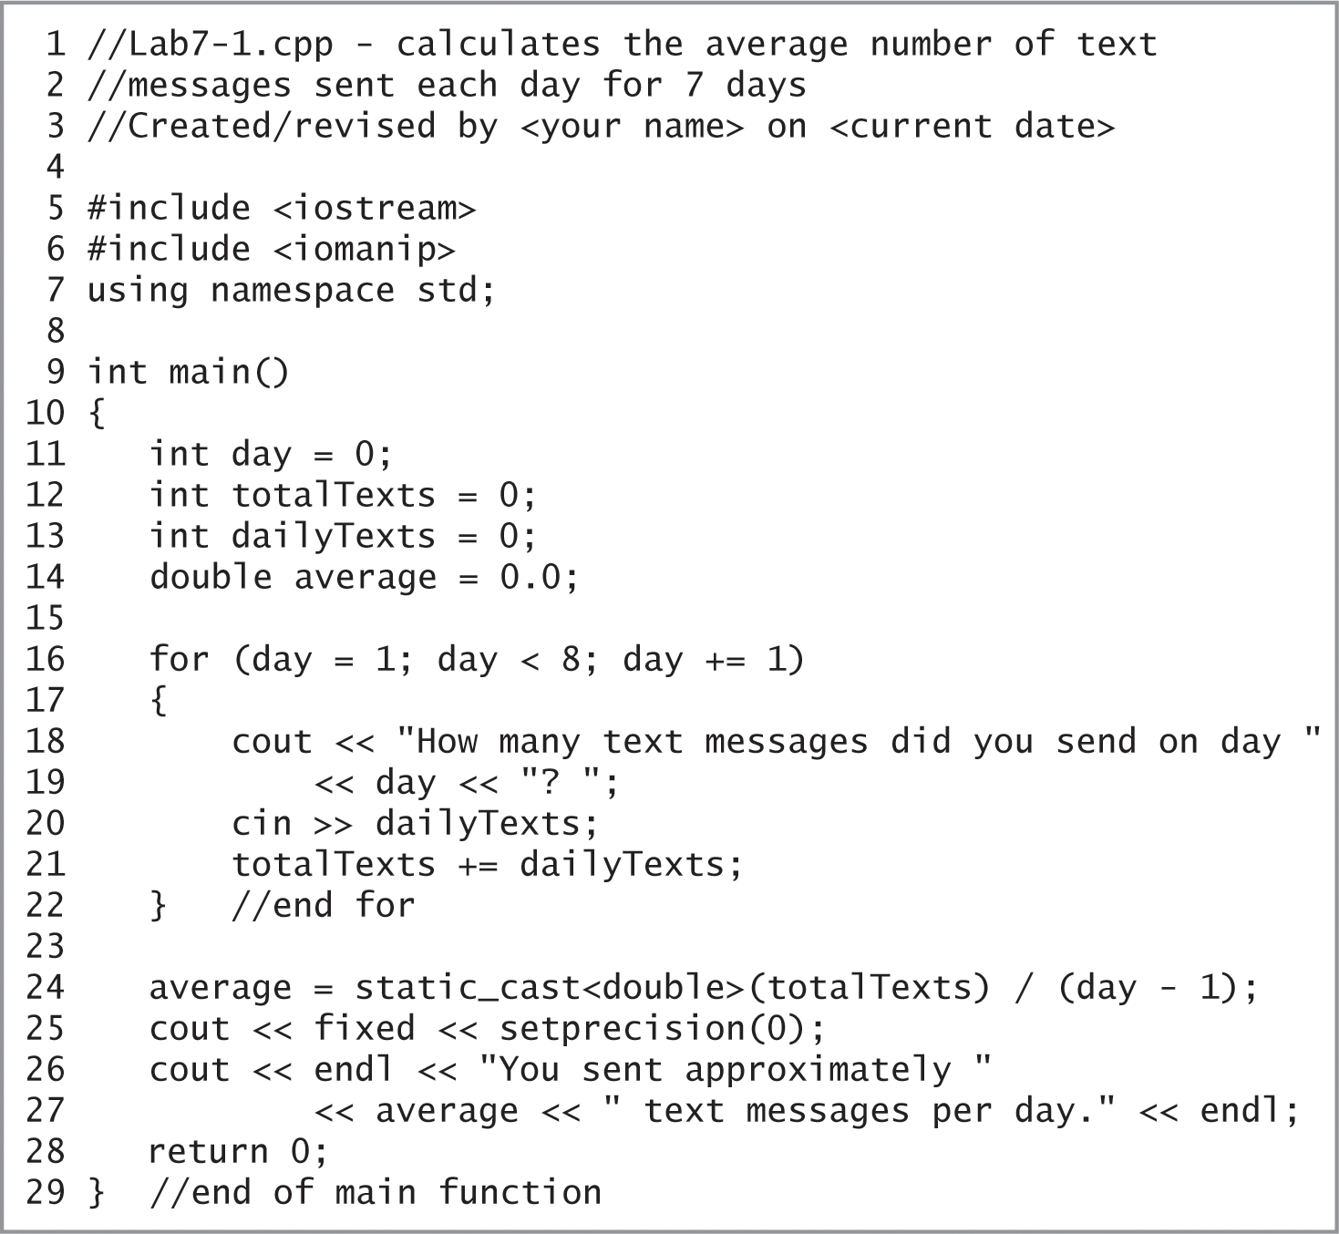
Lab 7-1: Stop and Analyze (cont’d.)
Figure 7-38 Code for Lab 7-1

Slide 66
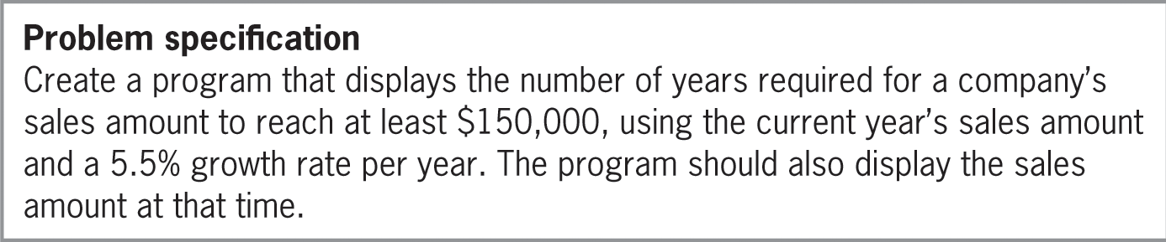
Lab 7-2: Plan and Create
Figure 7-39 Problem specification for Lab 7-2

Slide 67
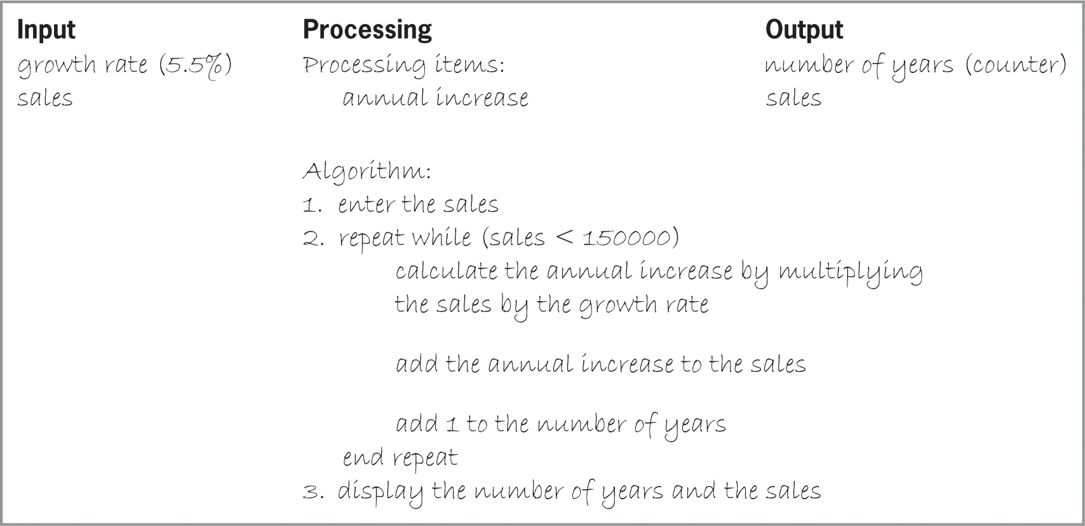
Lab 7-2: Plan and Create (cont’d.)
Figure 7-40 Completed IPO chart for Lab 7-2

Slide 68
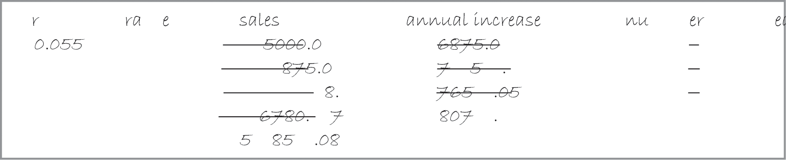
Lab 7-2: Plan and Create (cont’d.)
Figure 7-41 Completed desk-check table for Lab 7-2

Slide 69
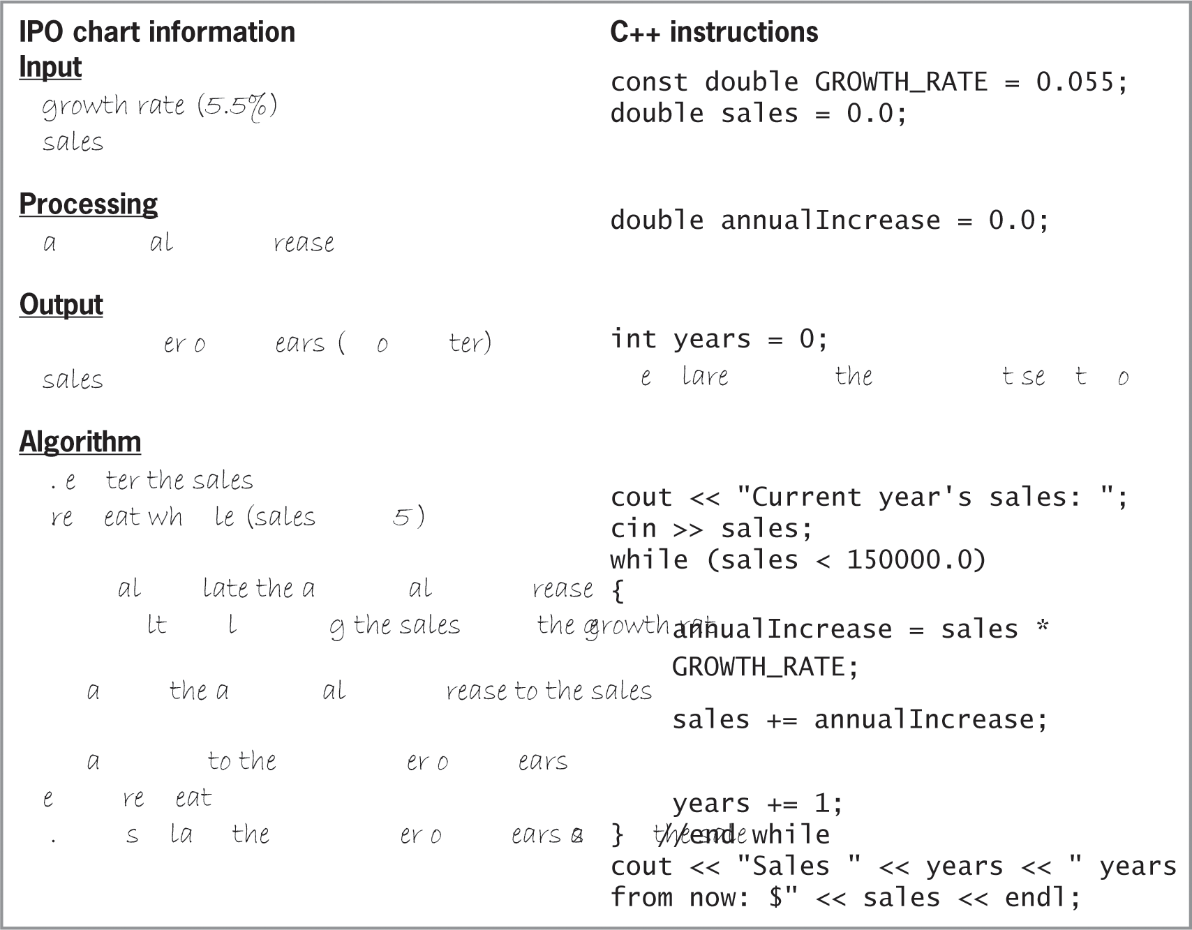
Lab 7-2: Plan and Create (cont’d.)
Figure 7-42 IPO chart and C++ instructions for Lab 7-2

Slide 70
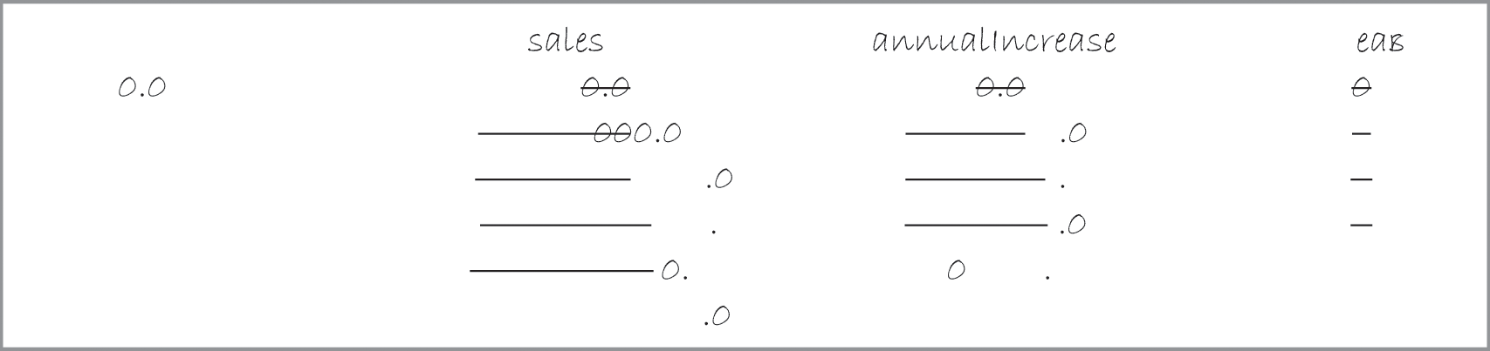
Lab 7-2: Plan and Create (cont’d.)
Figure 7-43 Completed desk-check table for Lab 7-2

Slide 71
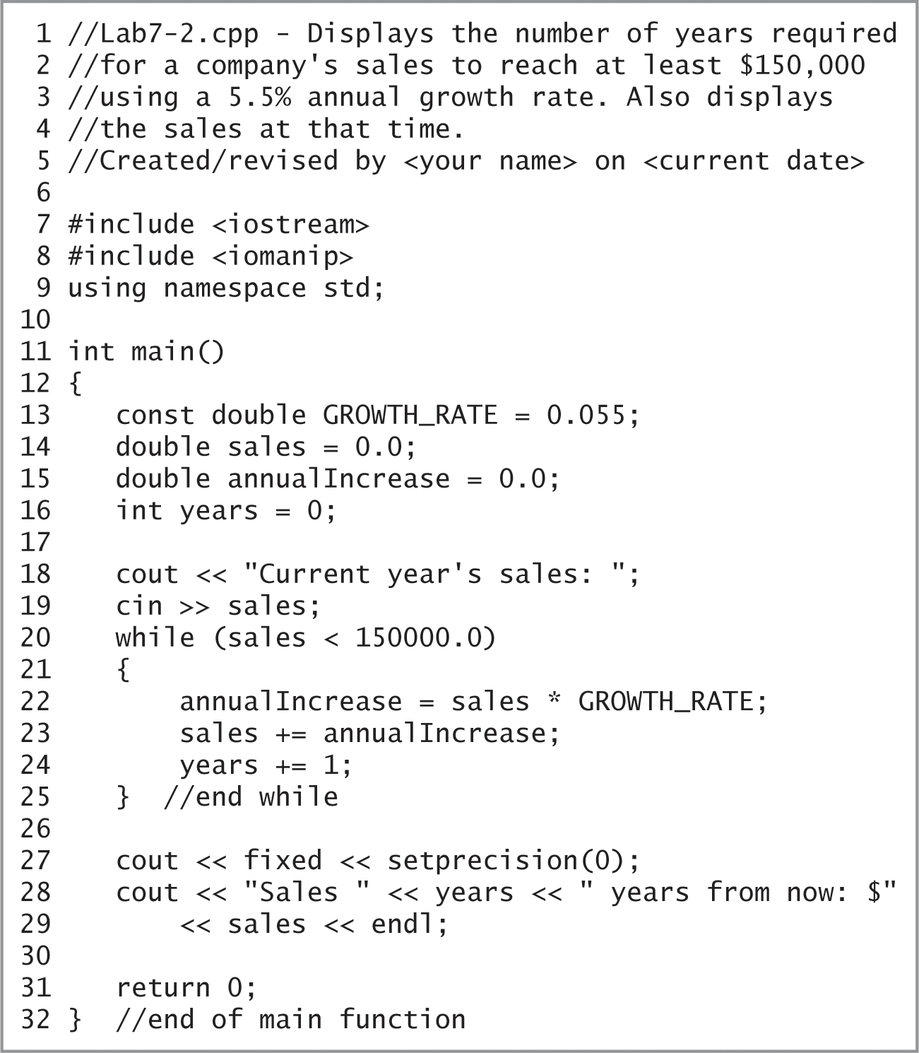
Lab 7-2: Plan and Create (cont’d.)
Figure 7-44 Finalized program for Lab 7-2

Slide 72
Lab 7-3: Modify
Modify the program in Lab7-1.cpp to utilize a while loop instead of a for loop. Save the modified program as Lab7-3.cpp
Test the program using the following data: 76, 80, 100, 43, 68, 70, and 79.

Slide 73
Lab 7-4: What’s Missing?
The program is this lab should display the average electric bill.
Follow the instructions for starting C++ and opening the Lab7-4.cpp file.
Put the C++ instructions in the proper order, and then determine the one or more missing instructions.
Test the program using the following monthly electric bills: 124.89, 110.65, 99.43, 100.35, and -1 (the sentinel value)

Slide 74
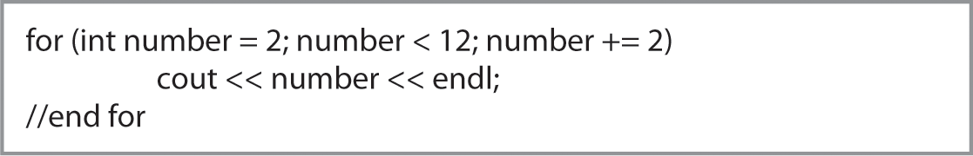
Lab 7-5: Desk-Check
The code in Figure 7-45 should display the numbers 2, 4, 6, 8, 10, and 12.
Desk-check the code; did your desk-check reveal any errors?
If so, correct the code and then desk-check it again
Figure 7-45 Code for Lab 7-5

Slide 75
Lab 7-6: Debug
Follow the instructions for starting C++ and opening the Lab7-6.cpp file
Run the program and enter 15.45 when prompted
The program goes into an infinite loop
Type Ctrl+c to end the program
Debug the program

